Slide 1
Module 7: Virtual Machine Management

Slide 2
Importance
Virtual machines are the foundation of your virtual infrastructure. Managing VMs effectively requires skills in creating templates and clones, modifying VMs, migrating VMs, taking snapshots, and protecting the VMs through replication and backups.

Slide 3
Module Lessons
Creating Templates and Clones
Working with Content Libraries
Modifying Virtual Machines
Migrating VMs with vSphere vMotion
Enhanced vMotion Compatibility
Migrating VMs with vSphere Storage vMotion
Creating Virtual Machine Snapshots
vSphere Replication and Backup

Slide 4
Virtual Beans: VM Management
Virtual Beans wants to automate its processes. It requires the following processes for the vSphere infrastructure:
Provisioning and deploying VMs: Performing fast, error-free, consistent deployments
Maintaining VMs: Patching and upgrading operating systems and applications
Backing up VMs: Making daily backups of application data
Disaster recovery and business continuity: Moving VMs between the primary and secondary data center
As a Virtual Beans administrator, you must recognize the options available for these processes. Then, you can create effective processes for managing VMs in your data center.

Slide 5

Lesson 1: Creating Templates and Clones

Slide 6
Learner Objectives
After completing this lesson, you should be able to meet the following objectives:
Create a template of a virtual machine
Deploy a virtual machine from a template
Clone a virtual machine
Create customization specifications for guest operating systems

Slide 7
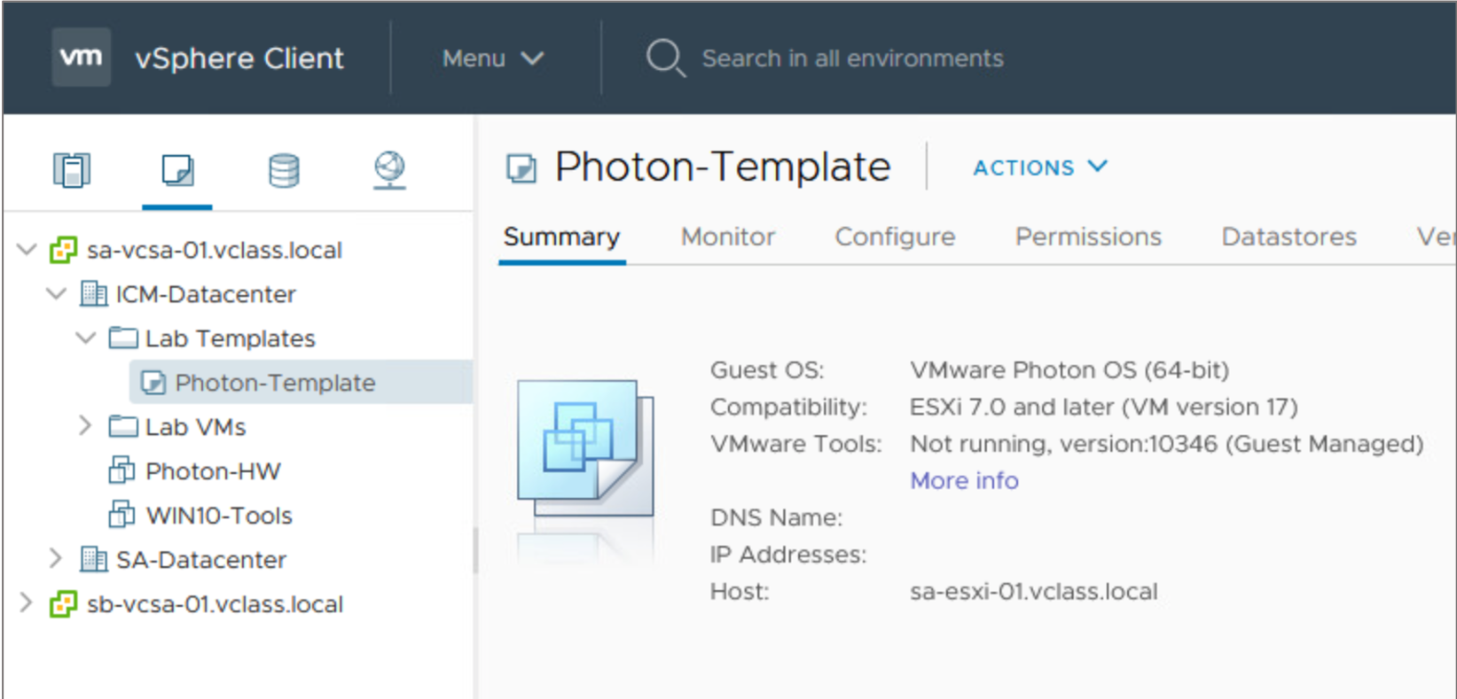
About Templates
A template is a master copy of a virtual machine. You use templates to create and provision new VMs.
A template typically includes:
A guest operating system
One or more applications
A specific VM configuration
VMware Tools
Notes:
Creating templates makes the provisioning of virtual machines much faster and less error-prone than provisioning physical machines and creating a VM by using the New Virtual Machine wizard.
Templates coexist with VMs in the inventory. You can organize collections of VMs and templates into arbitrary folders and apply permissions to VMs and templates. You can change VMs into templates without having to make a full copy of the VM files and create an object.
You can deploy a VM from a template. The deployed VM is added to the folder that you selected when creating the template.

Slide 8
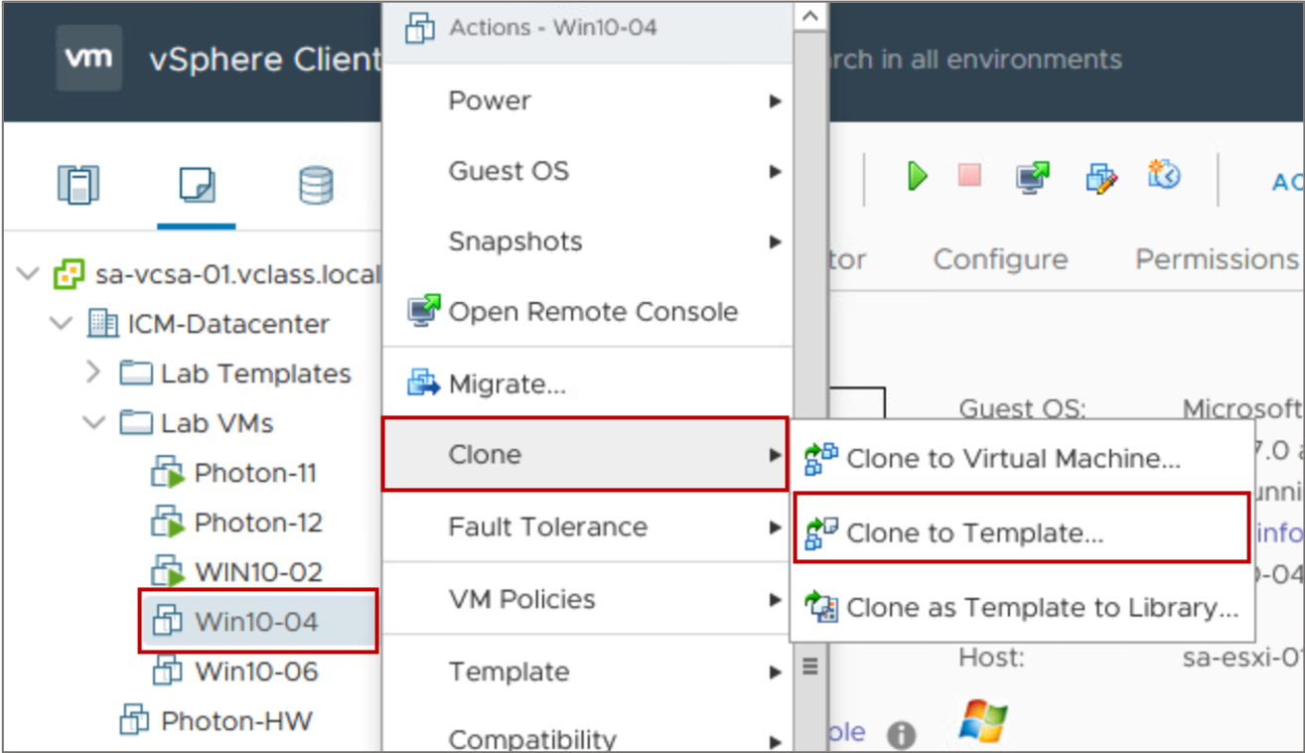
Creating a Template: Clone VM to Template
You can create templates using different methods. One method is to clone the VM to a template. The VM can be powered on or off.
Notes:
The Clone to Template option offers you a choice of format for storing the VM's virtual disks:
Same format as source
Thin-provisioned format
Thick-provisioned lazy-zeroed format
Thick-provisioned eager-zeroed format

Slide 9
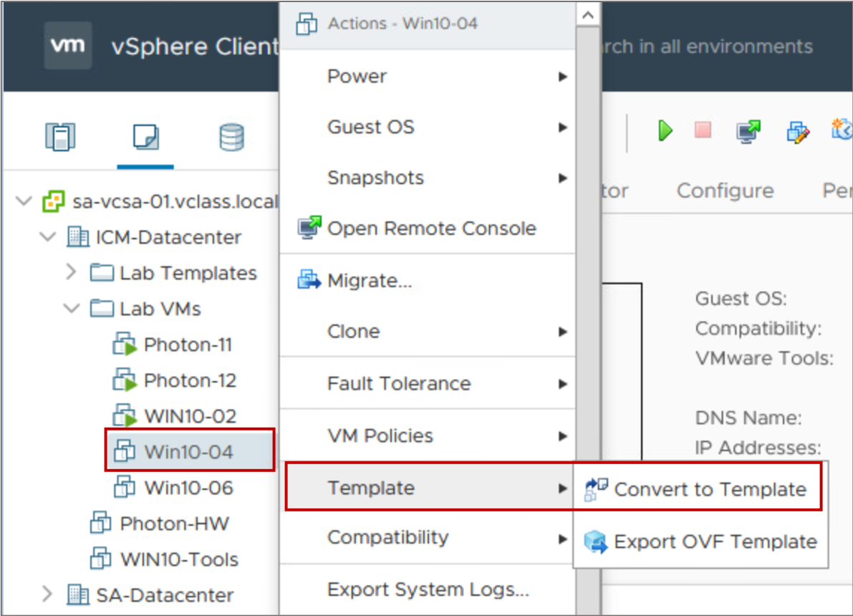
Creating a Template: Convert VM to Template
You can create a template by converting a VM to a template. In this case, the VM must be powered off.
Notes:
The Convert to Template option does not offer a choice of format and leaves the VM’s disk file intact.

Slide 10
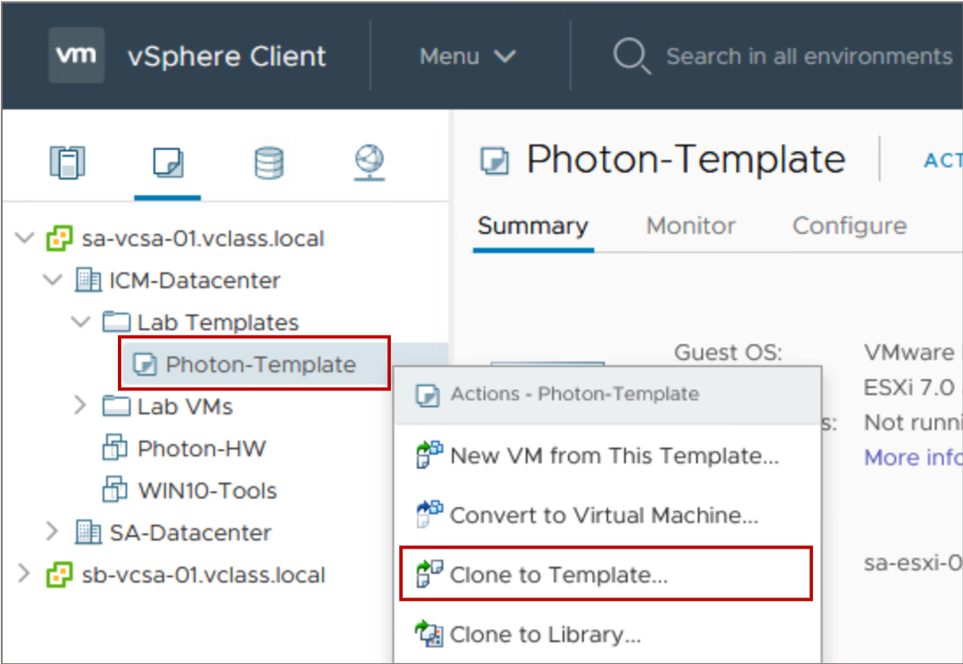
Creating a Template: Clone a Template
You can create a template from an existing template, or clone a template.

Slide 11
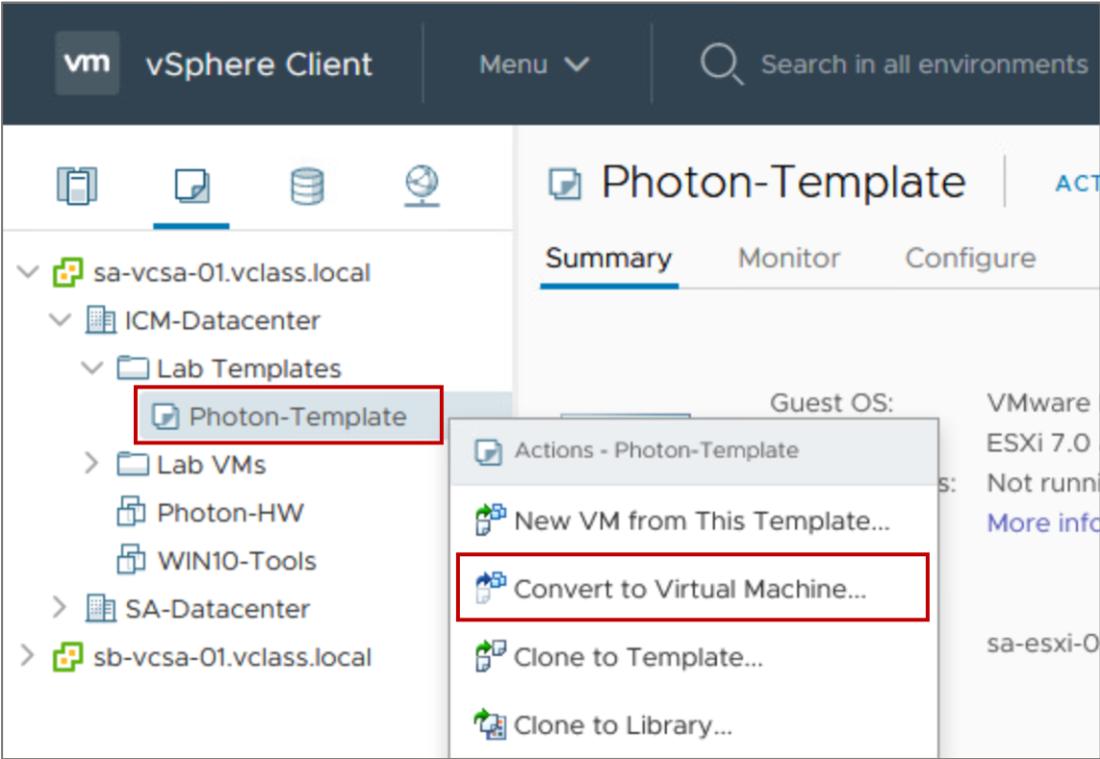
Updating Templates
You update a template to include new patches, make system changes, and install new applications.
To update a template:
Convert the template to a VM.
Place the VM on an isolated network to prevent user access.
Make appropriate changes to the VM.
Convert the VM to a template.
Notes:
To update your template to include new patches or software, you do not need to create a template. Instead, you convert the template to a VM. You can then power on the VM.
For added security, you might want to prevent users from accessing the VM while you update it. To prevent access, either disconnect the VM from the network or place it on an isolated network.
Log in to the VM’s guest operating system and apply the patch or install the software. When you finish, power off the VM and convert it to a template again.

Slide 12
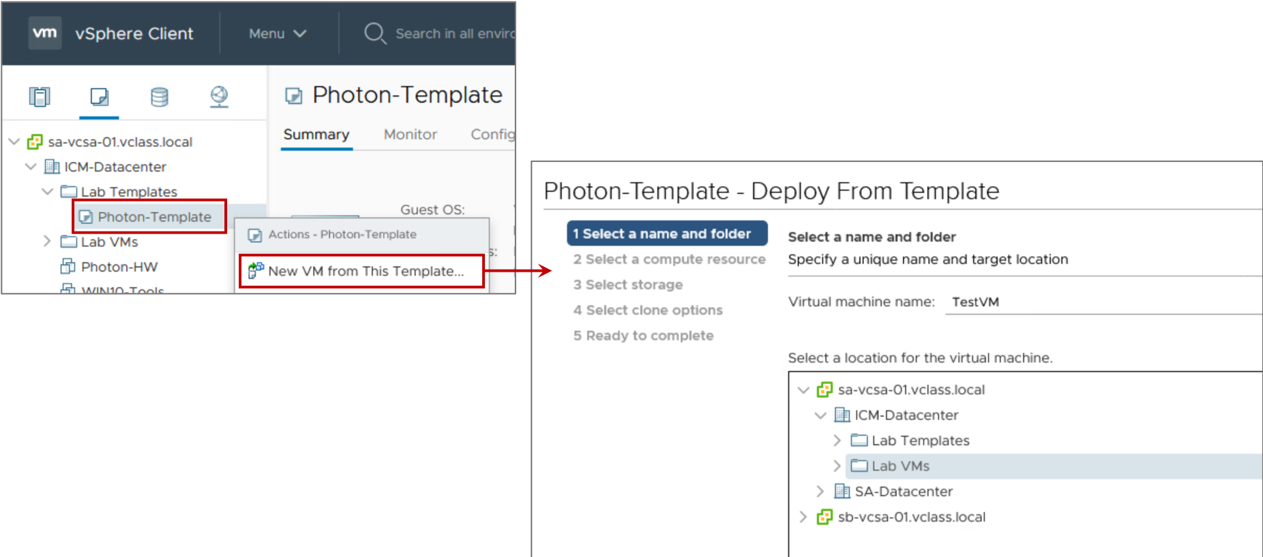
Deploying VMs from a Template
To deploy a VM, you must provide information such as the VM name, inventory location, host, datastore, and guest operating system customization data.
Notes:
When you place ISO files in a content library, the ISO files are available only to VMs that are registered on an ESXi host that can access the datastore where the content library is located. These ISO files are not available to VMs on hosts that cannot see the datastore on which the content library is located.

Slide 13
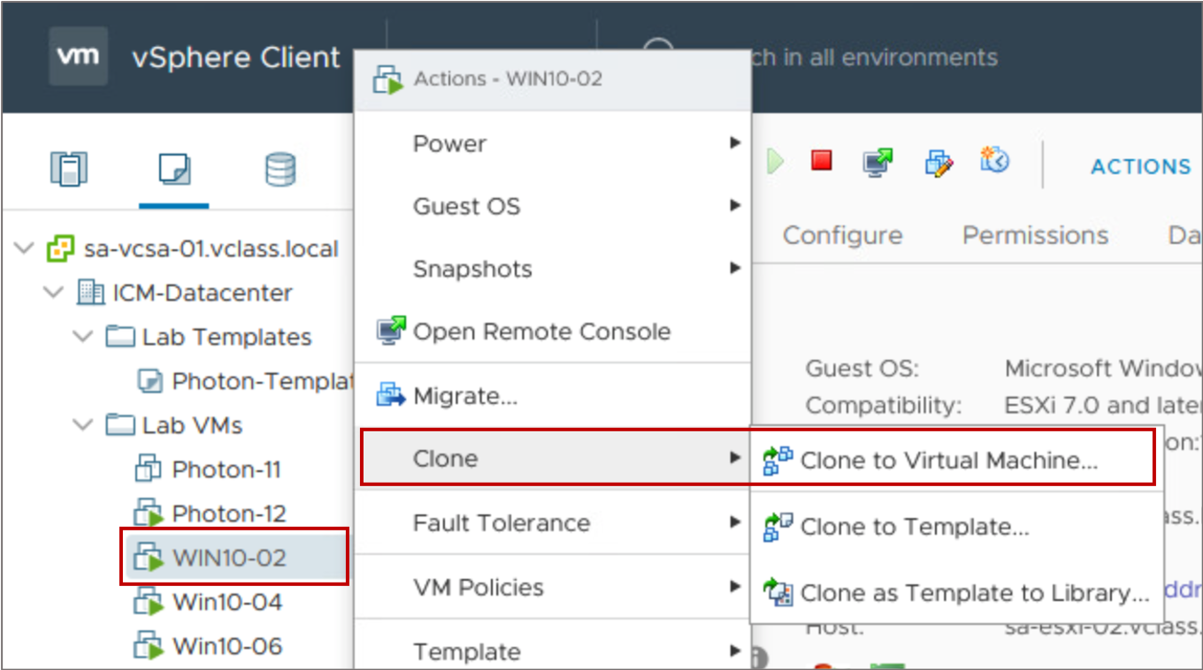
Cloning Virtual Machines
Cloning a VM creates a VM that is an exact copy of the original:
Cloning is an alternative to deploying a VM.
During cloning, the VM can be powered on or off.
Notes:
To clone a VM, you must be connected to vCenter Server. You cannot clone VMs if you use VMware Host Client to manage a host directly.
When you clone a VM that is powered on, services and applications are not automatically quiesced when the VM is cloned.
When deciding whether to clone a VM or deploy a VM from a template, consider the following points:
VM templates use storage space, so you must plan your storage space requirements accordingly.
Deploying a VM from a template is quicker than cloning a running VM, especially when you must deploy many VMs at a time.
When you deploy many VMs from a template, all the VMs start with the same base image. Cloning many VMs from a running VM might not create identical VMs, depending on the activity happening within the VM when the VM is cloned.

Slide 14
Guest Operating System Customization
You customize the guest operating system to make VMs, created from the same template or clone, unique.
By customizing a guest operating system, you can change information, including the following details:
Computer name
Network settings
License settings
Windows Security Identifier
Notes:
Customizing the guest operating system prevents conflicts that might occur when you deploy a VM and a clone with identical guest OS settings simultaneously.

Slide 15
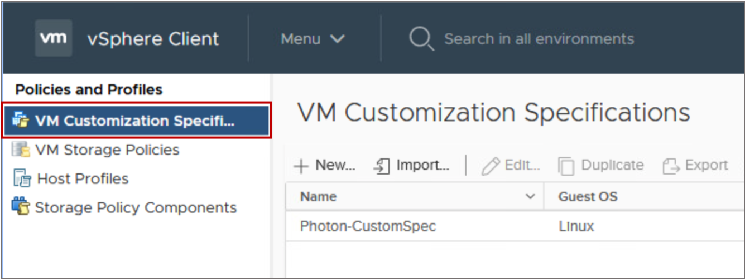
About Customization Specifications
You can create a customization specification to prepare the guest operating system:
Specifications are stored in the vCenter Server database.
Windows and Linux guests are supported.
Notes:
To manage customization specifications, select Policies and Profiles from the Menu drop-down menu. On the VM Customization Specifications pane, you can create specifications or manage existing ones.

Slide 16
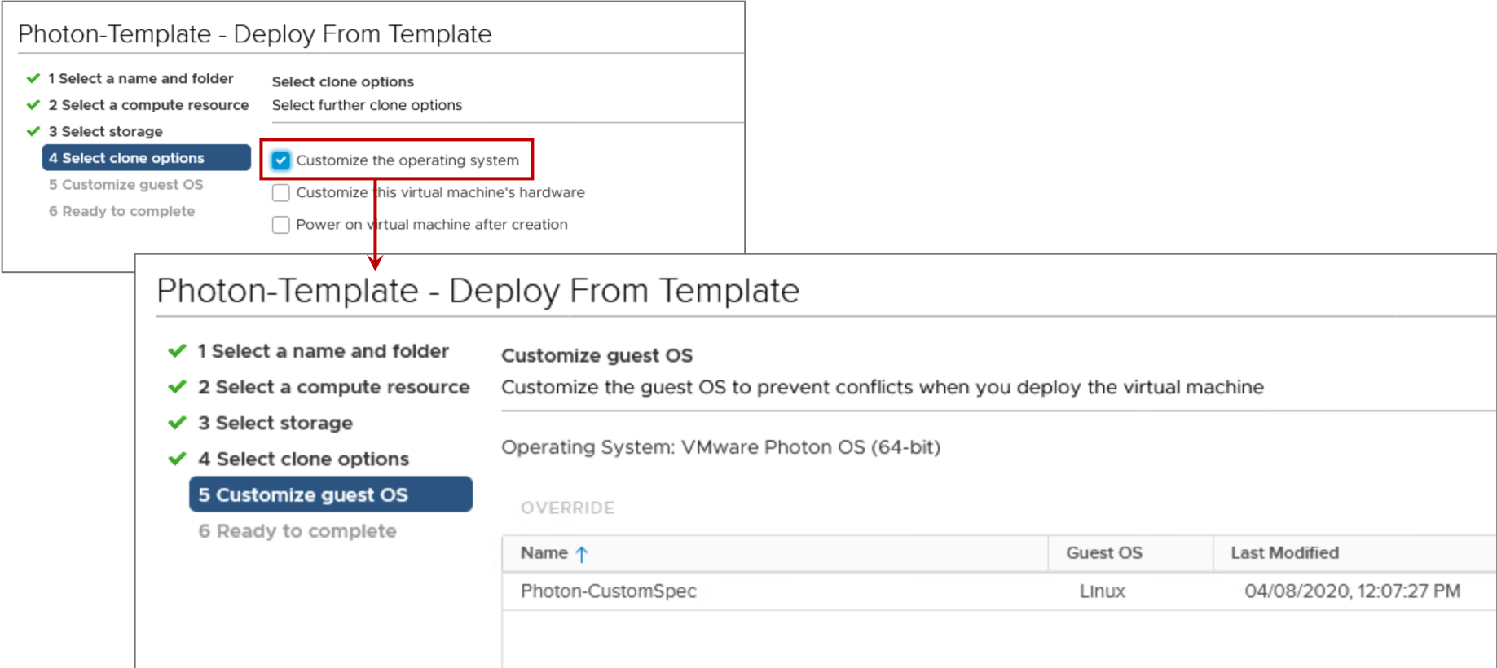
Customizing the Guest Operating System
When cloning a VM or deploying a VM from a template, you can use a customization specification to prepare the guest operating system.
Notes:
You can define the customization settings by using an existing customization specification during cloning or deployment. You create the specification ahead of time. During cloning or deployment, you can select the customization specification to apply to the new VM.
VMware Tools must be installed on the guest operating system that you want to customize. The guest operating system must be installed on a disk attached to SCSI node 0:0 in the VM configuration.
For more about guest operating system customization, see vSphere Virtual Machine Administration at https://docs.vmware.com/en/VMware-vSphere/7.0/com.vmware.vsphere.vm_admin.doc/GUID-55238059-912E-411F-A0E9-A7A536972A91.html.

Slide 17
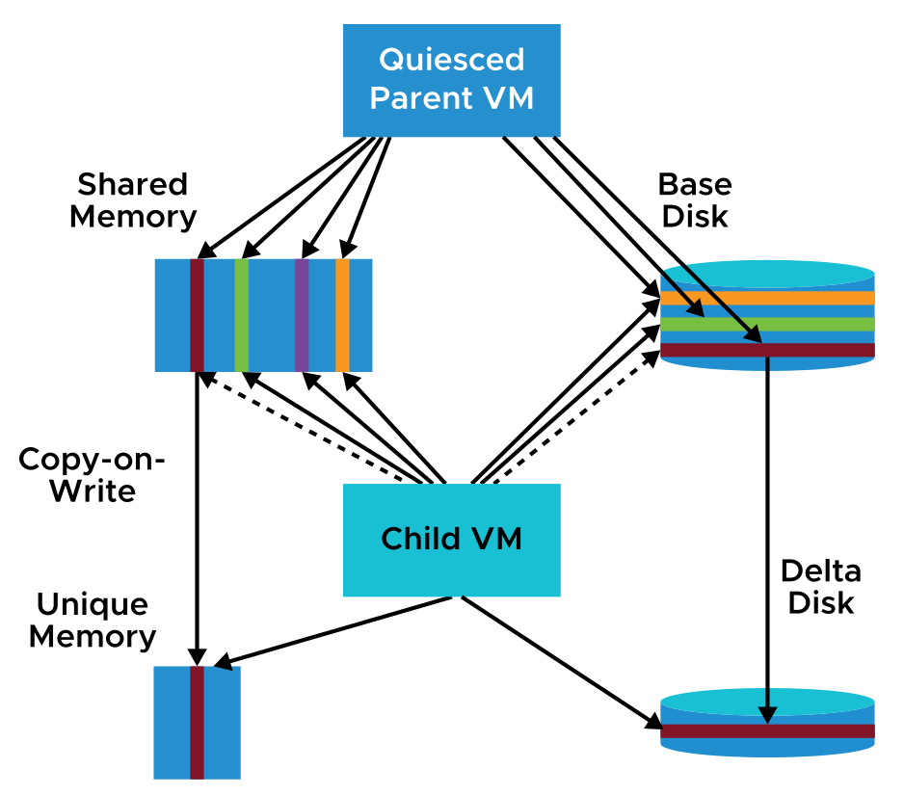
About Instant Clones
You can use Instant Clone Technology to create a powered-on VM from the running state of another powered-on VM:
The processor state, virtual device state, memory state, and disk state of the destination (child) VM are identical to the states of the source (parent) VM.
Snapshot-based disk sharing is used to provide storage efficiency and to improve the speed of the cloning process.
Notes:
Through instant cloning, the source (parent) VM does not lose its state because of the cloning process. You can move to just-in-time provisioning, given the speed and state-persisting nature of this operation.
During an instant clone operation, the source VM is stunned for a short time, less than 1 second. While the source VM is stunned, a new writable delta disk is generated for each virtual disk, and a checkpoint is taken and transferred to the destination VM. The destination VM powers on by using the source’s checkpoint. After the destination VM is fully powered on, the source VM resumes running.
Instant clone VMs are fully independent vCenter Server inventory objects. You can manage instant clone VMs like regular VMs, without any restrictions.

Slide 18
Use Cases for Instant Clones
Instant clone VMs have various uses:
Virtual desktop infrastructure
Rapid scale-out: Container hosts, big data, and Hadoop worker nodes
DevTest: Quickly and efficiently replicate VMs and test beds with the same running state
DevOps: Replicate VMs from staging to production, and the converse, with the identical running state
In vSphere 6.7 and later, you can create instant clones of VMs only through API calls.
In vSphere 7, instant clone guest customization is supported (Linux only).
Notes:
Instant cloning is convenient for large-scale application deployments because it ensures memory efficiency, and you can create many VMs on a single host.
To avoid network conflicts, you can customize the virtual hardware of the destination VM during the instant cloning operation. For example, you can customize the MAC addresses of the virtual NICs or the serial and parallel port configurations of the destination VM.
Starting with vSphere 7, you can customize the guest operating system for Linux VMs only. You can customize networking settings such as IP address, DNS server, and the gateway. You can change these settings without having to power off or restart the VM.

Slide 19
Lab 16: Using VM Templates: Creating Templates and Deploying VMs
Create a VM template, create a customization specification, and deploy VMs from a template:
Create a Virtual Machine Template
Create Customization Specifications
Deploy Virtual Machines from a Template

Slide 20
Review of Learner Objectives
After completing this lesson, you should be able to meet the following objectives:
Create a template of a virtual machine
Deploy a virtual machine from a template
Clone a virtual machine
Create customization specifications for guest operating systems

Slide 21
Lesson 2: Working with Content Libraries

Slide 22
Learner Objectives
After completing this lesson, you should be able to meet the following objectives:
Identify the benefits of a content library
Recognize types of content libraries
Deploy a virtual machine from a content library

Slide 23
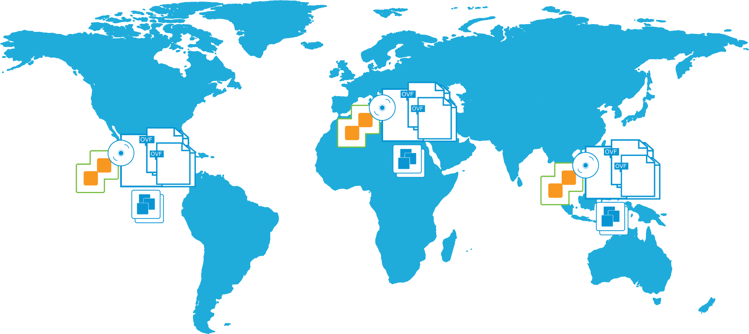
About Content Libraries
Content libraries are repositories of OVF templates and other file types that can be shared and synchronized across vCenter Server systems globally.
Notes:
Organizations might have multiple vCenter Server instances in data centers around the globe. On these vCenter Server instances, organizations might have a collection of templates, ISO images, and so on. The challenge is that all these items are independent of one another, with different versions of these files and templates on various vCenter Server instances.
The content library is the solution to this challenge. IT can store OVF templates, ISO images, or any other file types in a central location. The templates, images, and files can be published, and other content libraries can subscribe to and download content. The content library keeps content up to date by periodically synchronizing with the publisher, ensuring that the latest version is available.

Slide 24
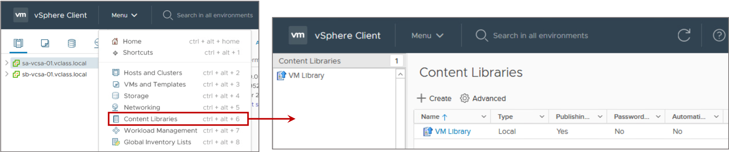
Benefits of Content Libraries
Storage and consistency are key reasons to install and use a content library.
Using content libraries, administrators can perform the following functions:
Store, version, and share content.
Perform distributed file management.
Synchronize content libraries across sites and vCenter Server instances.
Mount an ISO file directly from a content library.
Perform live updates of VM templates
Notes:
Sharing content and ensuring that the content is kept up to date are major tasks. For example, for a main vCenter Server instance, you create a central content library to store the master copies of OVF templates, ISO images, and other file types. When you publish this content library, other libraries, which might be located anywhere in the world, can subscribe and download an exact copy of the data. When an OVF template is added, modified, or deleted from the published catalog, the subscriber synchronizes with the publisher, and the libraries are updated with the latest content. Starting with vSphere 7, you can update a template while simultaneously deploying VMs from the template. In addition, the content library keeps two copies of the VM template, the previous and current versions. You can roll back the template to reverse changes made to the template.

Slide 25
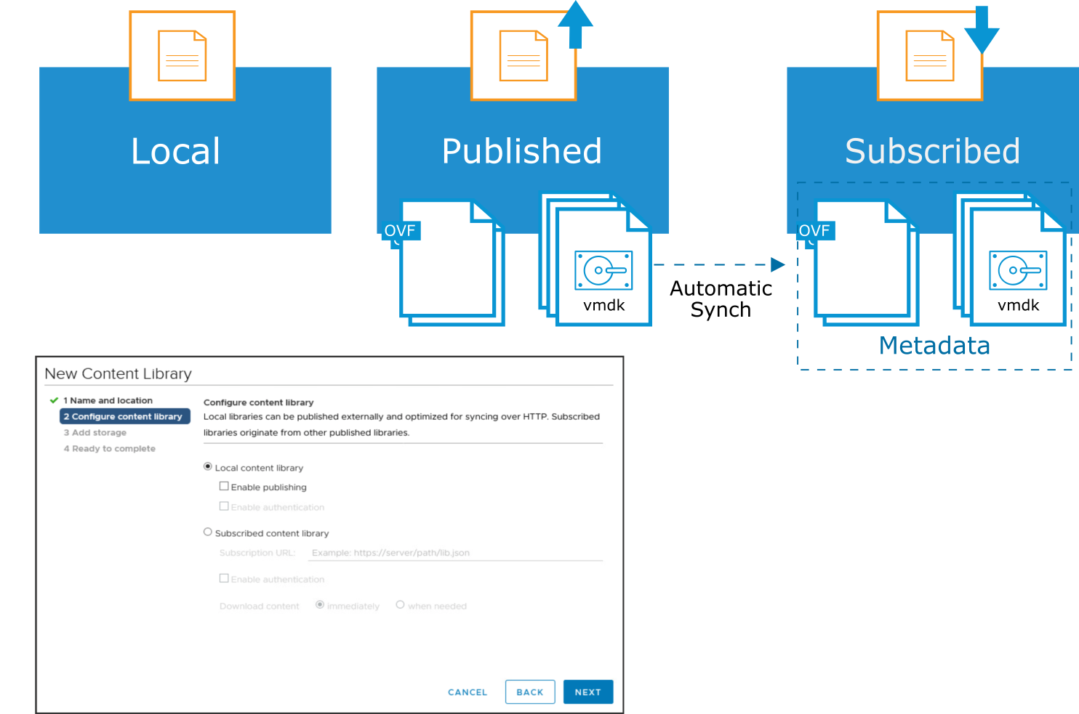
Types of Content Libraries
Types of content libraries are local, published, and subscribed.
Notes:
You can create a local library as the source for content that you want to save or share. You create the local library on a single vCenter Server instance. You can then add or remove items to and from the local library.
You can publish a local library, and this content library service endpoint can be accessed by other vCenter Server instances in your virtual environment. When you publish a library, you can configure the authentication method, which a subscribed library must use to authenticate to it.
You can create a subscribed library and populate its content by synchronizing it to a published library. A subscribed library contains copies of the published library files or only the metadata of the library items. The published library can be on the same vCenter Server instance as the subscribed library, or the subscribed library can reference a published library on a different vCenter Server instance. You cannot add library items to a subscribed library. You can add items only to a local or published library. After synchronization, both libraries contain the same items, or the subscribed library contains the metadata for the items.

Slide 26
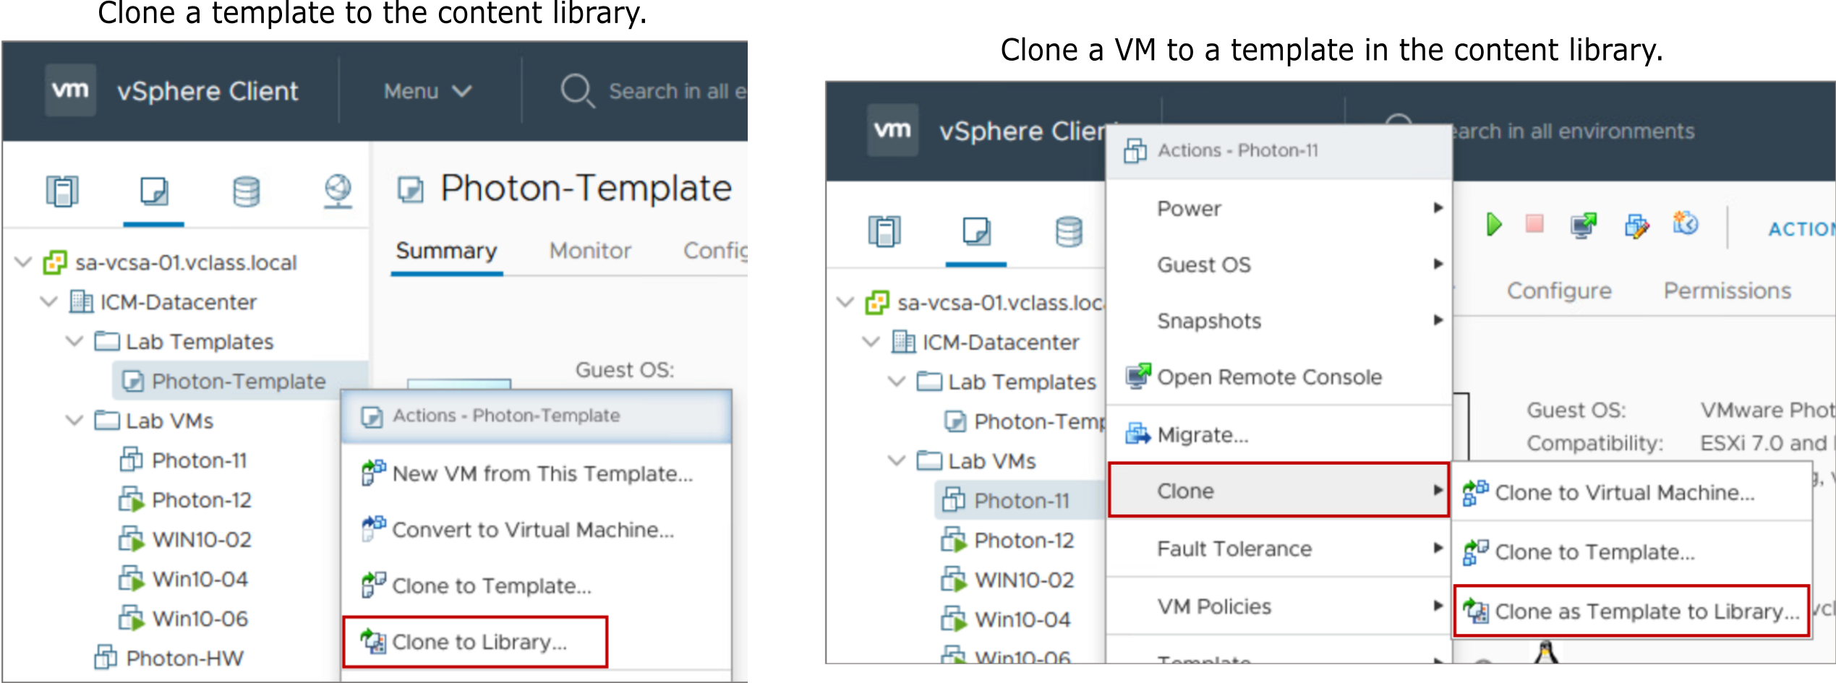
Adding VM Templates to a Content Library
Library items include VM templates, vApp templates, or other VMware objects that can be contained in a content library.
Notes:
VMs and vApps have several files, such as log files, disk files, memory files, and snapshot files that are part of a single library item. You can create library items in a specific local library or remove items from a local library. You can also upload files to an item in a local library so that the libraries subscribed to it can download the files to their NFS or SMB server, or datastore.

Slide 27
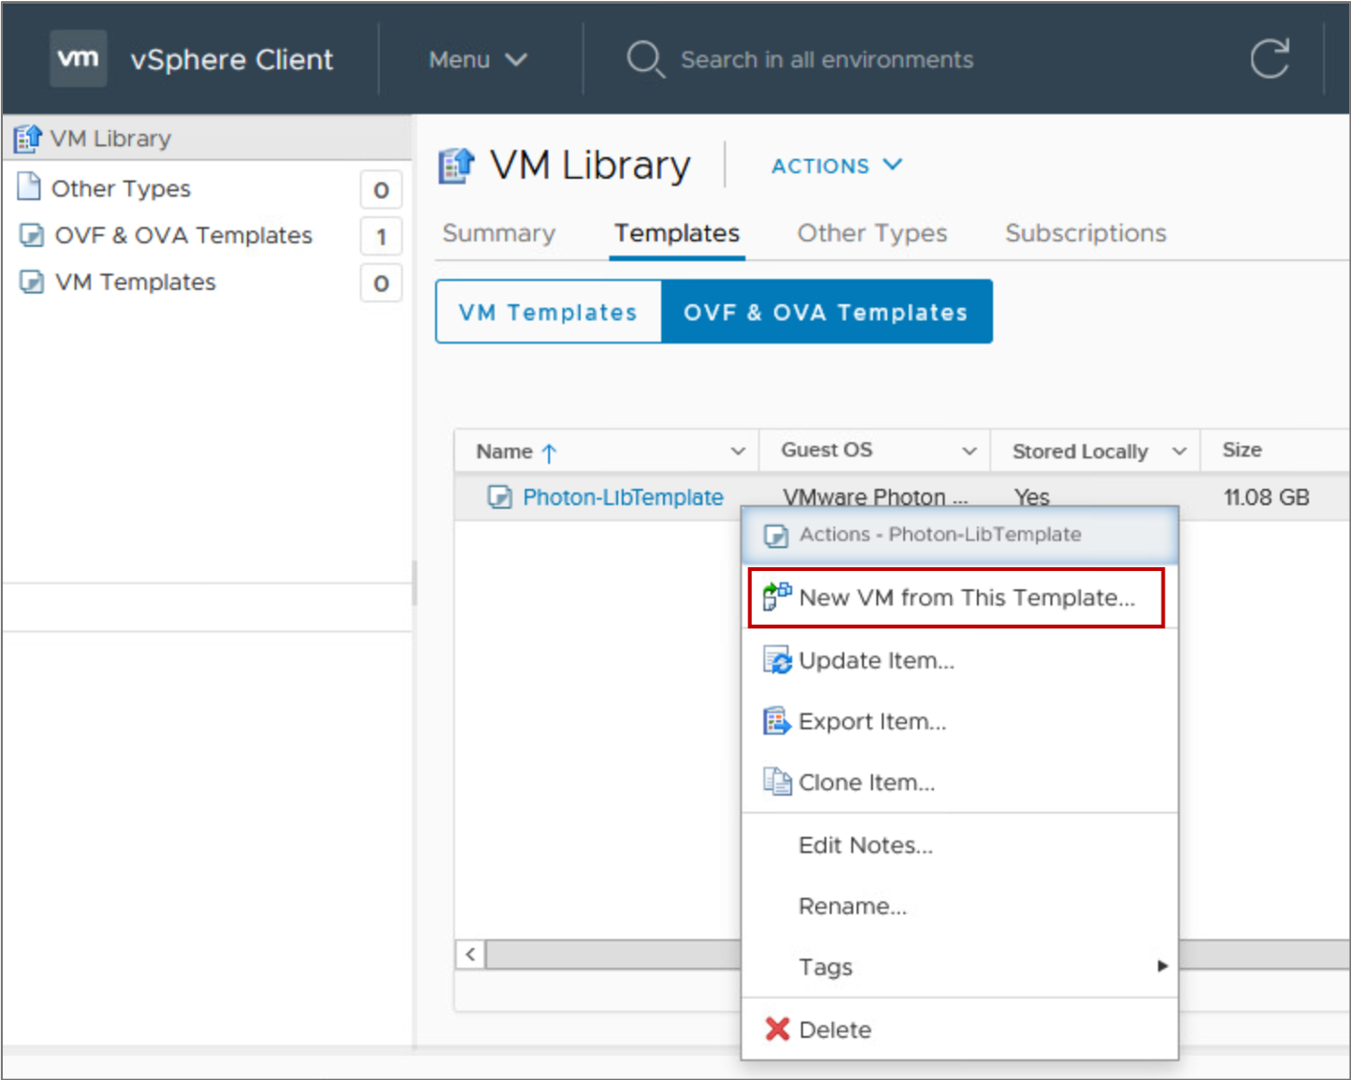
Deploying VMs from Templates in a Content Library
The templates in the content library can be used to deploy VMs and vApps.
Each VM template, vApp template, or other type of file in a library is a library item.
You can also mount an ISO file directly from a content library.

Slide 28
Lab 17: Using Content Libraries
Create a content library to clone and deploy virtual machines:
Create a Content Library
Clone a VM Template to a Template in a Content Library
Deploy a VM from a VM Template in the Content Library

Slide 29
Review of Learner Objectives
After completing this lesson, you should be able to meet the following objectives:
Identify the benefits of a content library
Recognize types of content libraries
Deploy a virtual machine from a content library

Slide 30
Lesson 3: Modifying Virtual Machines

Slide 31
Learner Objectives
After completing this lesson, you should be able to meet the following objectives:
Describe virtual machine settings and options
Add a hot-pluggable device
Dynamically increase the size of a virtual disk

Slide 32
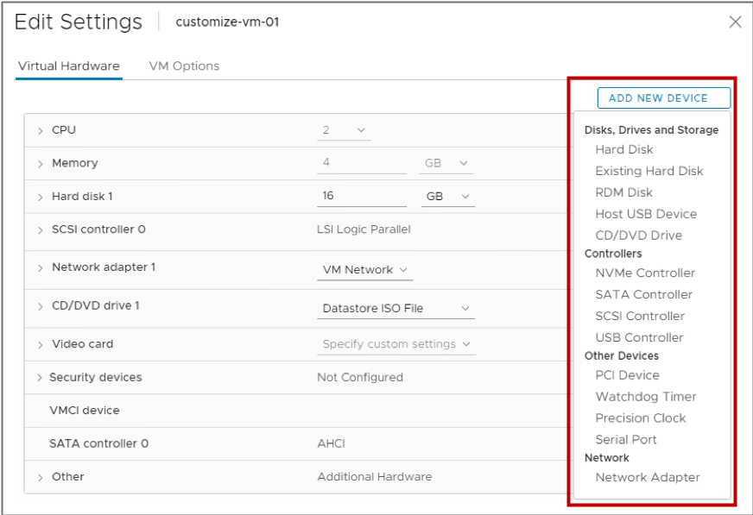
Modifying Virtual Machine Settings
You can modify a VM’s configuration by editing the VM's settings:
Add virtual hardware:
You can add some hardware while the VM is powered on.
Remove virtual hardware:
You can remove some hardware only when the VM is powered off.
Set VM options.
Control a VM’s CPU and memory resources.
Notes:
You might have to modify a VM’s configuration, for example, to add a network adapter or a virtual disk. You can make all VM changes while the VM is powered off. Some VM hardware changes can be made while the VM is powered on.
vSphere 7.0 makes the following virtual devices available:
Watchdog timer: Virtual device used to detect and recover from operating system problems. If a failure occurs, the watchdog timer attempts to reset or power off the VM. This feature is based on Microsoft specifications: Watchdog Resource Table (WDRT) and Watchdog Action Table (WDAT).
The watchdog timer is useful with high availability solutions such as Red Hat High Availability and the MS SQL failover cluster. This device is also useful on VMware Cloud and in hosted environments for implementing custom failover logic to reset or power off VMs.
Precision Clock: Virtual device that presents the ESXi host's system time to the guest OS. Precision Clock helps the guest operating system achieve clock accuracy in the 1 millisecond range. The guest operating system uses Precision Clock time as reference time. Precision Clock is not directly involved in guest OS time synchronization.
Precision Clock is useful when precise timekeeping is a requirement for the application, such as for financial services applications. Precision Clock is also useful when precise time stamps are required on events that track financial transactions.
Virtual SGX: Virtual device that exposes Intel's SGX technology to VMs. Intel’s SGX technology prevents unauthorized programs or processes from accessing certain regions in memory. Intel SGX meets the needs of the Trusted Computing Industry.
Virtual SGX is useful for applications that must conceal proprietary algorithms and encryption keys from unauthorized users. For example, cloud service providers cannot inspect a client’s code and data in a virtual SGX-protected environment.

Slide 33
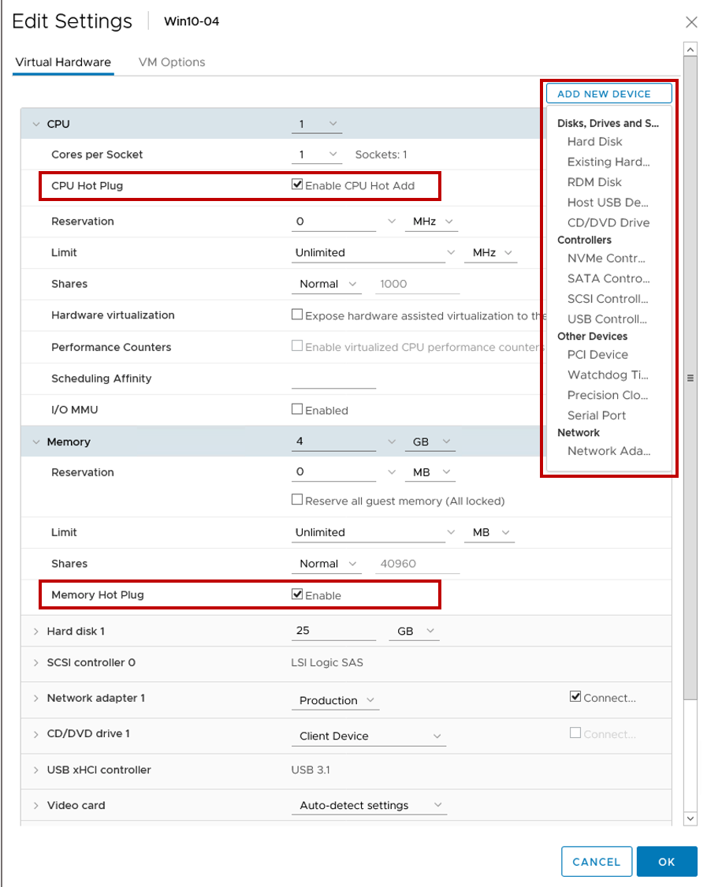
Hot-Pluggable Devices
With the hot plug option, you can add resources to a running VM.
Examples of hot-pluggable devices:
USB controllers
Ethernet adapters
Hard disk devices
With supported guest operating systems, you can also add CPU and memory while the VM is powered on.
Notes:
Adding devices to a physical server or removing devices from a physical server requires that you physically interact with the server in the data center. When you use VMs, resources can be added dynamically without a disruption in service. You must shut down a VM to remove hardware, but you can reconfigure the VM without entering the data center.
You can add CPU and memory while the VM is powered on. These features are called the CPU Hot Add and Memory Hot Plug, which are supported only on guest operating systems that support hot-pluggable functionality. These features are disabled by default. To use these hot-plug features, the following requirements must be satisfied:
You must install VMware Tools.
The VM must use hardware version 11 or later.
The guest operating system in the VM must support CPU and memory hot-plug features.
The hot-plug features must be enabled in the CPU or Memory settings on the Virtual Hardware tab.
If virtual NUMA is configured with virtual CPU hot-plug settings, the VM is started without virtual NUMA. Instead, the VM uses UMA (Uniform Memory Access).

Slide 34
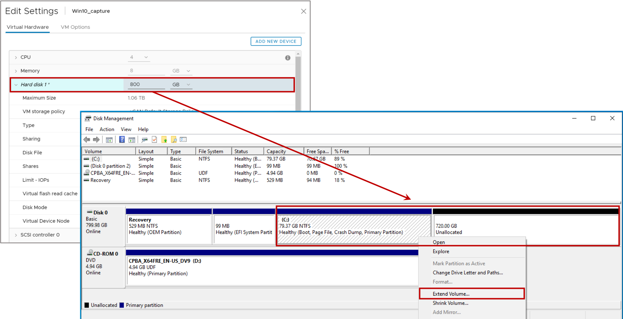
Dynamically Increasing Virtual Disk Size
You can increase the size of a virtual disk that belongs to a powered-on VM.
Notes:
When you increase the size of a virtual disk, the VM must not have snapshots attached.
After you increase the size of a virtual disk, you might need to increase the size of the file system on this disk. Use the appropriate tool in the guest OS to enable the file system to use the newly allocated disk space.

Slide 35
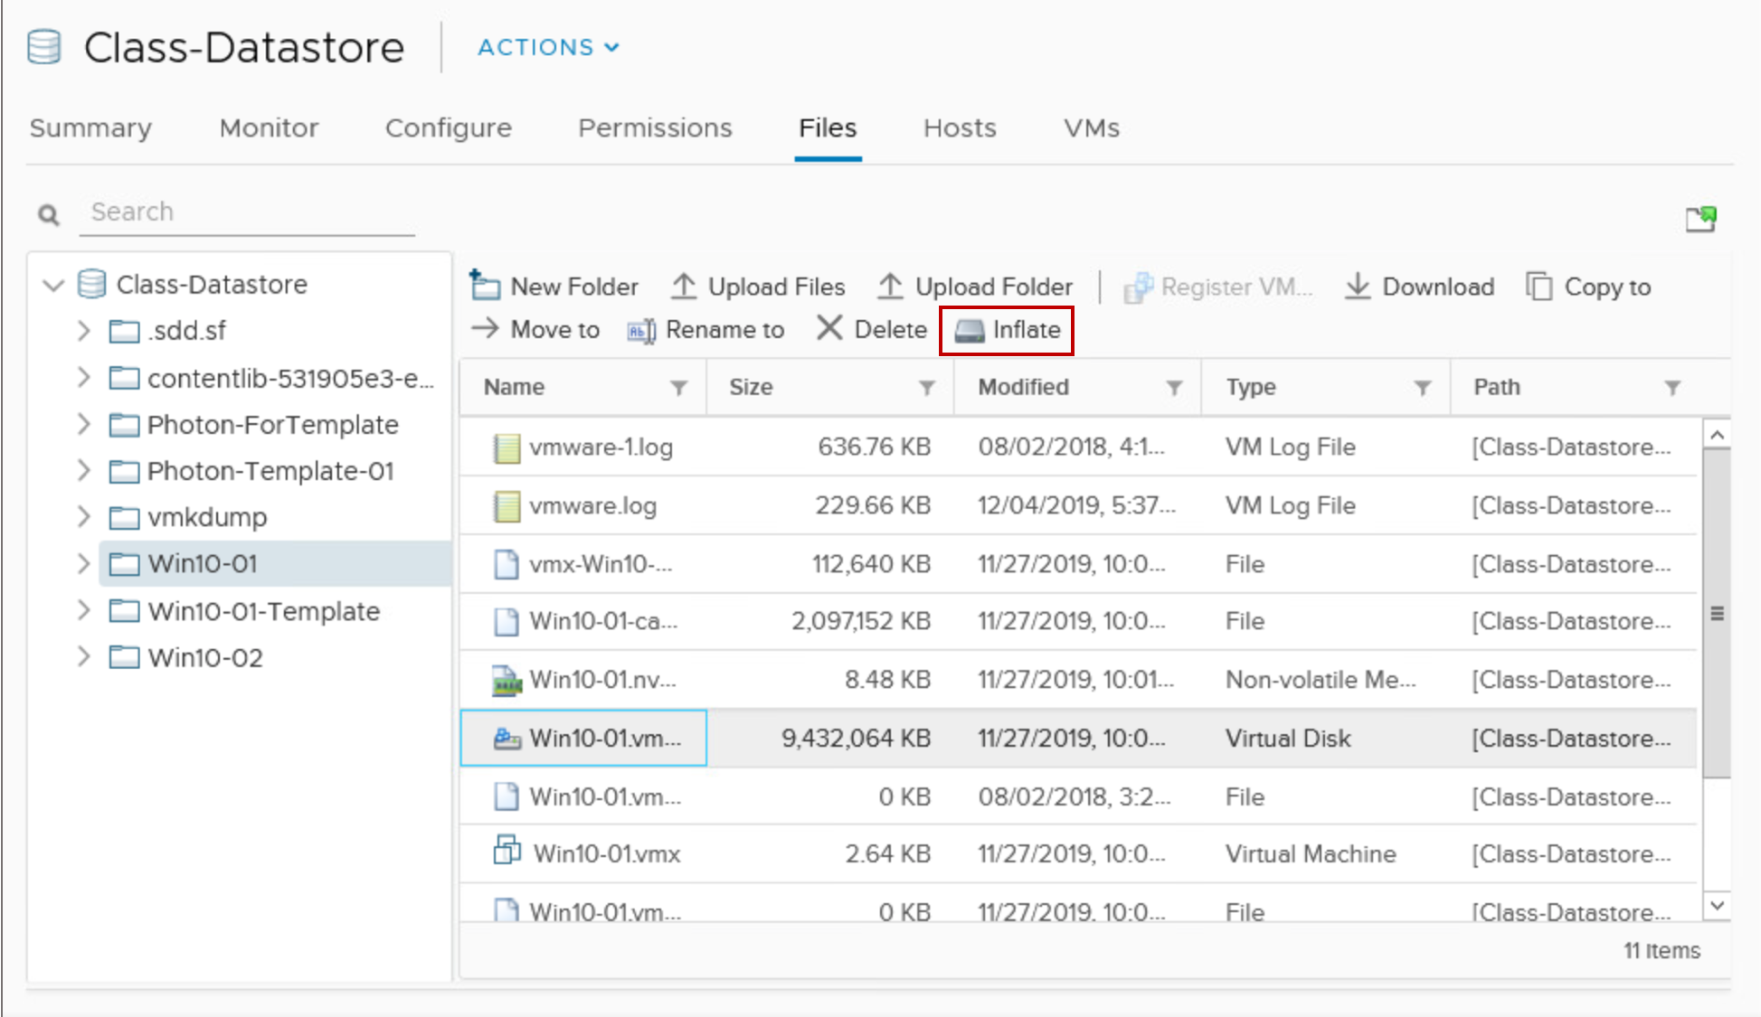
Inflating Thin-Provisioned Disks
Thin-provisioned virtual disks can be converted to a thick, eager-zeroed format.
To inflate a thin-provisioned disk:
The VM must be powered off.
Right-click the VM’s file with the .vmdk extension and select Inflate.
Or you can use vSphere Storage vMotion and select a thick-provisioned disk as the destination.
Notes:
When you inflate a thin-provisioned disk, the inflated virtual disk occupies the entire datastore space originally provisioned to it. Inflating a thin-provisioned disk converts a thin disk to a virtual disk in thick-provisioned format.

Slide 36
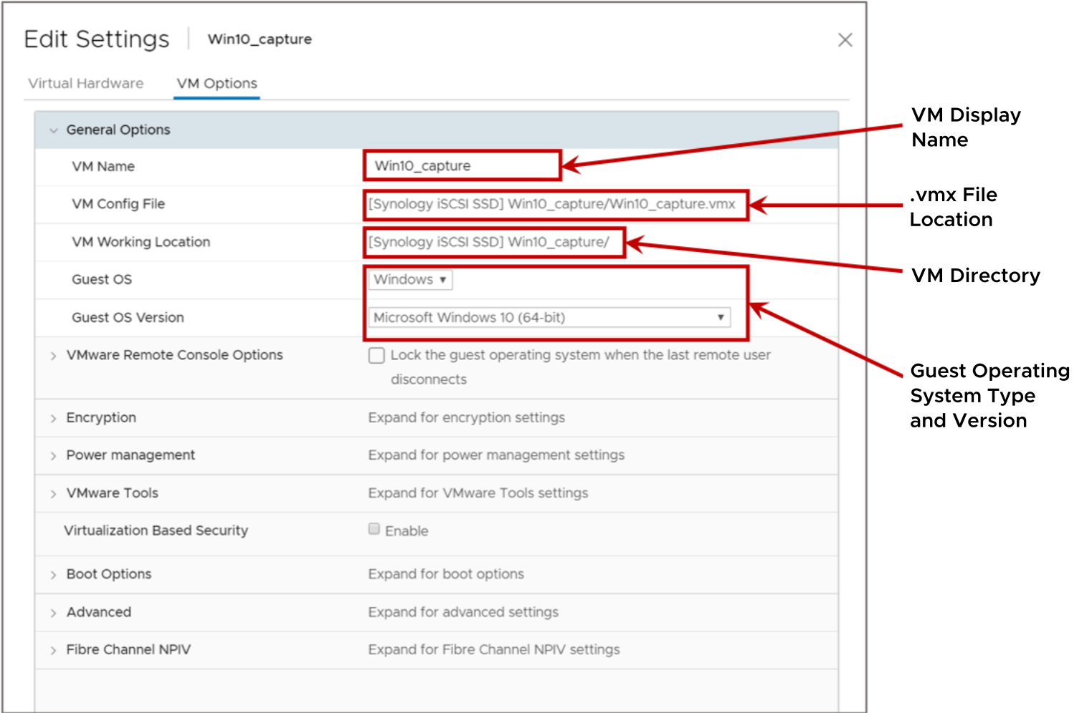
VM Options: General Settings
You can use the VM Options tab to modify properties such as the display name for the VM and the type of guest operating system that is installed.
Notes:
Under General Options, you can view the location and name of the configuration file (with the .vmx extension) and the location of the VM’s directory.
You can select the text for the configuration file and the working location to copy and paste them into a document. However, only the display name and the guest operating system type can be modified.
Changing the display name does not change the names of all the VM files or the directory that the VM is stored in. When a VM is created, the filenames and the directory name associated with the VM are based on its display name. But changing the display name later does not modify the filename and the directory name.

Slide 37
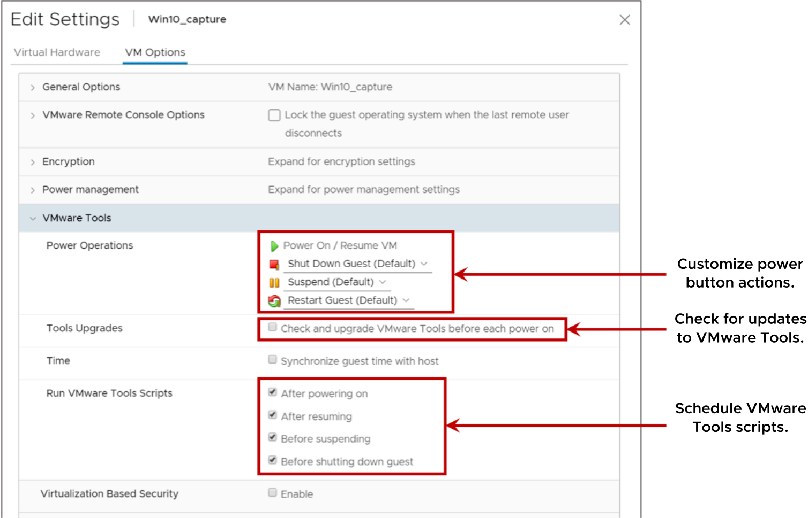
VM Options: VMware Tools Settings
You can use the VMware Tools controls to customize the power buttons on the VM.
Notes:
When you use the VMware Tools controls to customize the power buttons on the VM, the VM must be powered off.
You can select the Check and upgrade VMware Tools before each power on check box to check for a newer version of VMware Tools. If a newer version is found, VMware Tools is upgraded when the VM is power cycled.
When you select the Synchronize guest time with host check box, the guest operating system’s clock synchronizes with the host.
For information about time keeping best practices for the guest operating systems that you use, see VMware knowledge base articles 1318 at http://kb.vmware.com/kb/1318 and 1006427 at http://kb.vmware.com/kb/1006427.

Slide 38
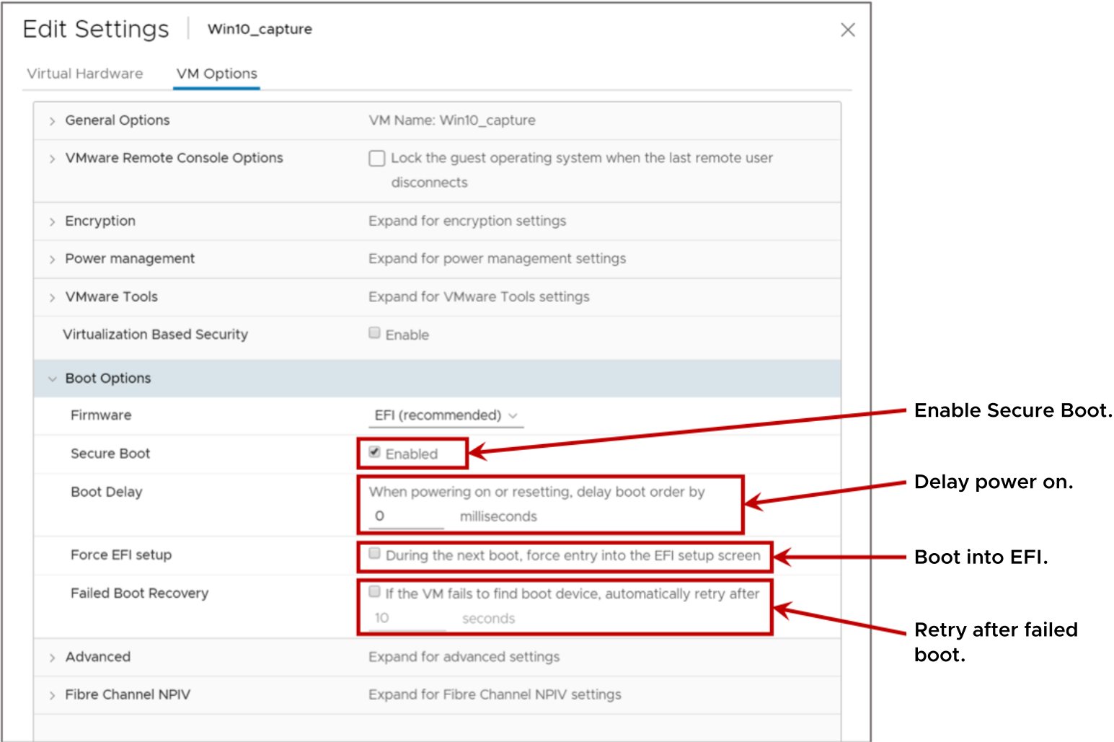
VM Options: VM Boot Settings
Occasionally, you might need to set the VM boot options.
Notes:
When you build a VM and select a guest operating system, BIOS or EFI is selected automatically, depending on the firmware supported by the operating system. Mac OS X Server guest operating systems support only Extensible Firmware Interface (EFI). If the operating system supports BIOS and EFI, you can change the boot option as needed. However, you must change the option before installing the guest OS.
UEFI Secure Boot is a security standard that helps ensure that your PC boots use only software that is trusted by the PC manufacturer. In an OS that supports UEFI Secure Boot, each piece of boot software is signed, including the bootloader, the operating system kernel, and operating system drivers. If you enable Secure Boot for a VM, you can load only signed drivers into that VM.
With the Boot Delay value, you can set a delay between the time when a VM is turned on and the guest OS starts to boot. A delayed boot can help stagger VM start ups when several VMs are powered on.
You can change the BIOS or EFI settings. For example, you might want to force a VM to start from a CD/DVD. The next time the VM powers on, it goes straight into the BIOS. A forced entry into the firmware setup is much easier than powering on the VM, opening a console, and quickly trying to press the F2 key.
With the Failed Boot Recovery setting, you can configure the VM to retry booting after 10 seconds (the default) if the VM fails to find a boot device.

Slide 39
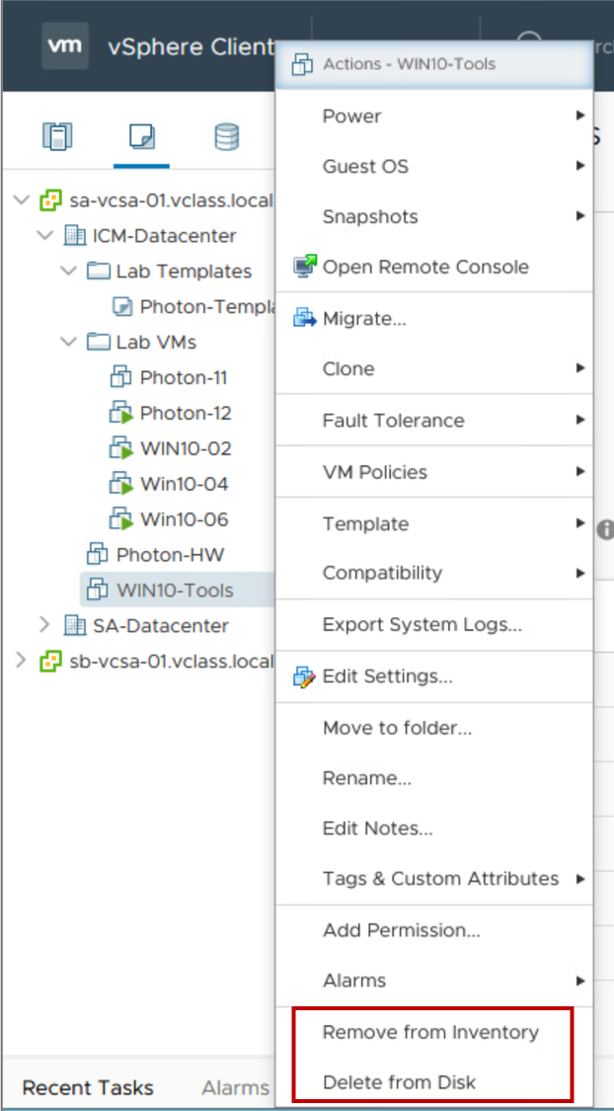
Removing VMs
You can remove a VM in the following ways:
Remove from the inventory:
The VM is unregistered from the ESXi host and vCenter Server.
The VM’s files remain on the disk.
The VM can later be registered (added) to the inventory.
Delete from disk:
All VM files are permanently deleted from the datastore.
The VM is unregistered from the ESXi host and vCenter Server.
Notes:
When a VM is removed from the inventory, its files remain at the same storage location, and the VM can be re-registered in the datastore browser.

Slide 40
Lab 18: Modifying Virtual Machines
Modify a virtual machine’s hardware and rename a virtual machine:
Adjust Memory Allocation on a Virtual Machine
Increase the Size of a VMDK File
Rename a Virtual Machine in the vCenter Server Inventory

Slide 41
Review of Learner Objectives
After completing this lesson, you should be able to meet the following objectives:
Describe virtual machine settings and options
Add a hot-pluggable device
Dynamically increase the size of a virtual disk

Slide 42
Lesson 4: Migrating VMs with vSphere vMotion

Slide 43
Learner Objectives
After completing this lesson, you should be able to meet the following objectives:
Recognize the types of VM migrations that you can perform within a vCenter Server instance and across vCenter Server instances
Explain how vSphere vMotion works
Verify vSphere vMotion requirements
Migrate virtual machines using vSphere vMotion

Slide 44
About VM Migration
Migration means moving a VM from one host, datastore, or vCenter Server instance to another host, datastore, or vCenter Server instance.
Depending on the power state of the VM that you migrate, migration can be cold or hot:
A cold migration involves moving a powered-off or suspended VM to a new host.
A hot migration involves moving a powered-on VM to a new host.
Depending on the VM resource type, you can perform different types of migrations.
Migration Type | Description
Compute resource only | Move VM, but not its storage, to another host. For a hot migration, vSphere vMotion is used to move the VM.
Storage only | Move a VM's storage, but not its host, to a new datastore. For a hot migration, vSphere Storage vMotion is used to move the VM.
Both compute resource and storage | Move a VM to another host and datastore. For a hot migration, vSphere vMotion and vSphere Storage vMotion are used to move the VM.
Notes:
A deciding factor for using a particular migration technique is the purpose of performing the migration. For example, you might need to stop a host for maintenance but keep the VMs running. You use vSphere vMotion to migrate the VMs instead of performing a cold or suspended VM migration. If you must move a VM’s files to another datastore to better balance the disk load or transition to another storage array, you use vSphere Storage vMotion.
Some migration techniques, such as vSphere vMotion migration, have special hardware requirements that must be met to function properly. Other techniques, such as a cold migration, do not have special hardware requirements to function properly.
You can perform the different types of migration on either powered-off (cold) or powered-on (hot) VMs.

Slide 45
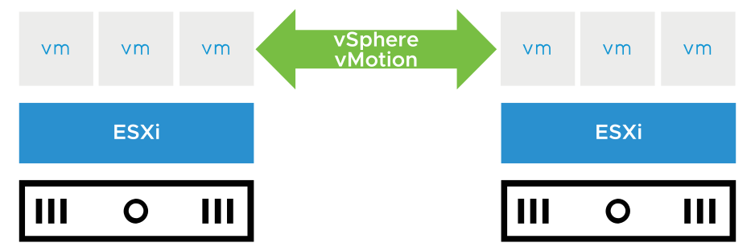
About vSphere vMotion
A vSphere vMotion migration moves a powered-on VM from one host to another. vSphere vMotion changes the compute resource only.
vSphere vMotion provides the following capabilities:
Improvement in overall hardware use
Continuous VM operation while accommodating scheduled hardware downtime
vSphere DRS to balance VMs across hosts
Notes:
Using vSphere vMotion, you can migrate running VMs from one ESXi host to another ESXi host with no disruption or downtime. With vSphere vMotion, vSphere DRS can migrate running VMs from one host to another to ensure that the VMs have the resources that they require.
With vSphere vMotion, the entire state of the VM is moved from one host to another, but the data storage remains in the same datastore.
The state information includes the current memory content and all the information that defines and identifies the VM. The memory content includes transaction data and whatever bits of the operating system and applications are in memory. The definition and identification information stored in the state includes all the data that maps to the VM hardware elements, such as the BIOS, devices, CPU, and MAC addresses for the Ethernet cards.

Slide 46
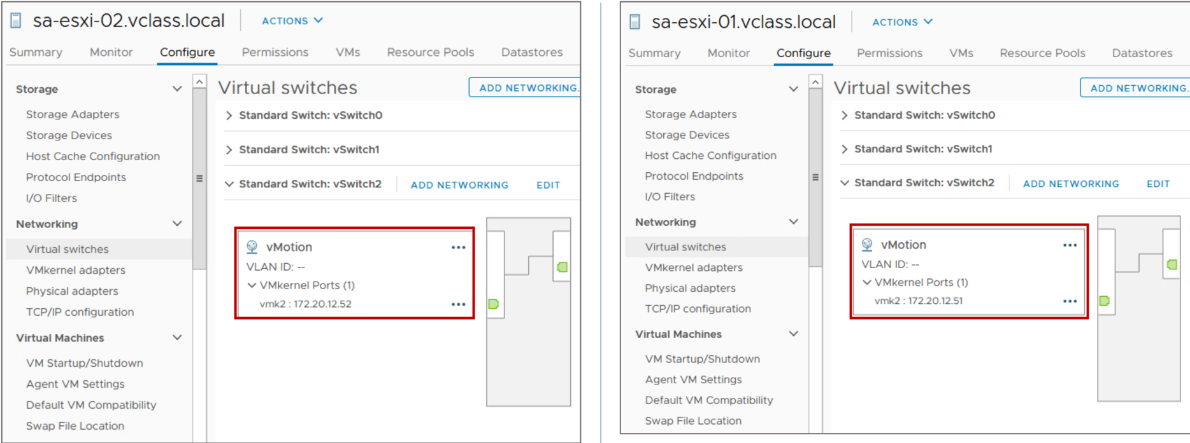
Enabling vSphere vMotion
To enable vSphere vMotion, you must configure a VMkernel port with the vSphere vMotion service enabled on the source and destination host.

Slide 47
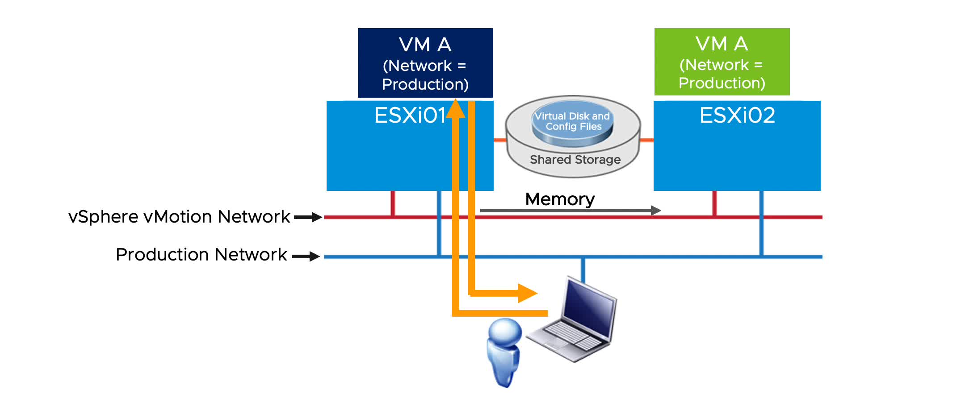
vSphere vMotion Migration Workflow
The source host (ESXi01) and the destination host (ESXi02) can access the shared datastore that holds the VM’s files.
Notes:
To play the animation, go to https://vmware.bravais.com/s/FbzaDb6owpSMKyKc940F.
A vSphere vMotion migration consists of the following steps:
A shadow VM is created on the destination host.
The VM’s memory state is copied over the vSphere vMotion network from the source host to the target host through the vSphere vMotion network. Users continue to access the VM and, potentially, update pages in memory. A list of modified pages in memory is kept in a memory bitmap on the source host.
After the first pass of memory state copy completes, another pass of memory copy is performed to copy any pages that changed during the last iteration. This iterative memory copying continues until no changed pages remain.
After most of the VM’s memory is copied from the source host to the target host, the VM is quiesced. No additional activity occurs on the VM. In the quiesce period, vSphere vMotion transfers the VM device state and memory bitmap to the destination host.
Immediately after the VM is quiesced on the source host, the VM is initialized and starts running on the target host. A Gratuitous Address Resolution Protocol (GARP) request notifies the subnet that VM A’s MAC address is now on a new switch port.
Users access the VM on the target host instead of the source host.
The memory pages that the VM was using on the source host are marked as free.

Slide 48
VM Requirements for vSphere vMotion Migration
For migration with vSphere vMotion, a VM must meet these requirements:
If it uses an RDM disk, the RDM file and the LUN to which it maps must be accessible by the destination host.
It must not have a connection to a virtual device, such as a CD/DVD or floppy drive, with a host-local image mounted.
In vSphere 7, you can use vSphere vMotion to migrate a VM with a device attached through a remote console.
Remote devices include physical devices or disk images on the client machine running the remote console.
Notes:
For the complete list of vSphere vMotion migration requirements, see vCenter Server and Host Management at https://docs.vmware.com/en/VMware-vSphere/7.0/com.vmware.vsphere.vcenterhost.doc/GUID-3B5AF2B1-C534-4426-B97A-D14019A8010F.html.

Slide 49
Host Requirements for vSphere vMotion Migration (1)
Source and destination hosts must have the following characteristics:
Accessibility to all the VM’s storage:
128 concurrent migrations are possible per VMFS or NFS datastore.
If the swap file location on the destination host differs from the swap file location on the source host, the swap file is copied to the new location.
VMkernel port with vSphere vMotion enabled
Matching management network IP address families (IPv4 or IPv6) between the source and destination hosts
Notes:
You cannot migrate a VM from a host that is registered to vCenter Server with an IPv4 address to a host that is registered with an IPv6 address. Copying a swap file to a new location can result in slower migrations. If the destination host cannot access the specified swap file location, it stores the swap file with the VM configuration file.

Slide 50
Host Requirements for vSphere vMotion Migration (2)
At least a 1 Gigabit Ethernet (1 GigE) network:
Each active vSphere vMotion process requires a minimum throughput of 250 Mbit/second on the vSphere vMotion network.
Concurrent migrations are limited to four on a 1 Gbps network.
Concurrent migrations are limited to eight on a 10 Gbps (or faster) network.
For better performance, dedicate at least two port groups to the vSphere vMotion traffic.
Compatible CPUs:
The CPU feature sets of both the source host and the destination host must be compatible.
Some features can be hidden by using Enhanced vMotion Compatibility or compatibility masks.
Notes:
Using 1 GbE network adapters for the vSphere vMotion network might result in migration failure, if you migrate VMs with large vGPU profiles.

Slide 51
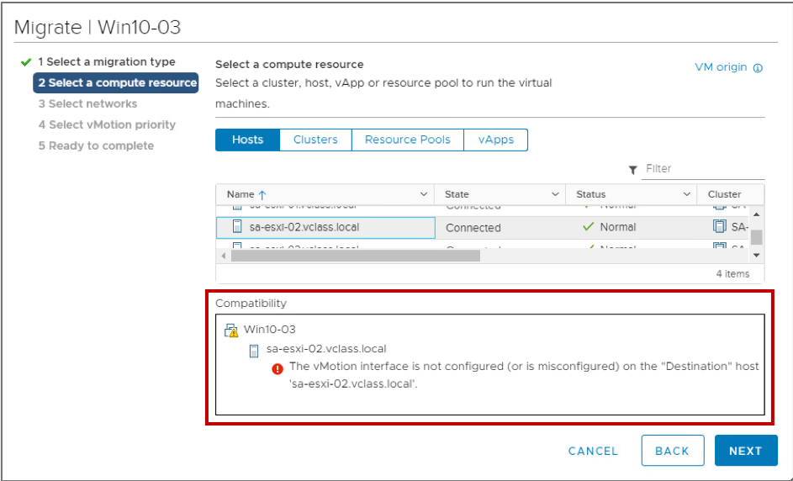
Checking vSphere vMotion Errors
When you select the host and cluster, a validation check is performed to verify that most vSphere vMotion requirements are met.
Notes:
If validation succeeds, you can continue in the wizard. If validation does not succeed, a list of vSphere vMotion errors and warnings displays in the Compatibility pane.
With warnings, you can still perform a vSphere vMotion migration. But with errors, you cannot continue. You must exit the wizard and fix all errors before retrying the migration.
If a failure occurs during the vSphere vMotion migration, the VM is not migrated and continues to run on the source host.

Slide 52
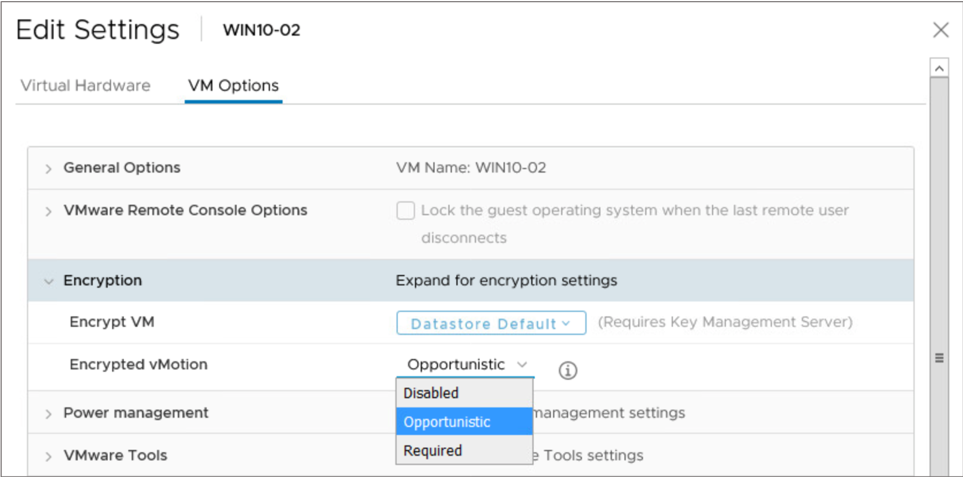
Encrypted vSphere vMotion
When migrating encrypted VMs, you always use encrypted vSphere vMotion.
For VMs that are not encrypted, select one of the following encrypted vSphere vMotion menu items:
Disabled.
Opportunistic (default): Encrypted vSphere vMotion is used if the source and destination hosts support it.
Required: If the source or destination host does not support encrypted vSphere vMotion, the migration fails.
Notes:
Encrypted vSphere vMotion secures confidentiality, integrity, and authenticity of data that is transferred with vSphere vMotion. Encrypted vSphere vMotion supports all variants of vSphere vMotion, including migration across vCenter Server systems. Encrypted vSphere Storage vMotion is not supported.
You cannot turn off encrypted vSphere vMotion for encrypted VMs.

Slide 53
Cross vCenter Migrations
With vSphere vMotion, you can migrate VMs between linked vCenter Server systems.
Migration of VMs across vCenter Server instances is helpful in the following cases:
Balancing workloads across clusters and vCenter Server instances that are in the same site or in another geographical area.
Moving VMs between environments that have different purposes, for example, from a development environment to production environment.
Moving VMs to meet different Service Level Agreements (SLAs) for storage space, performance, and so on.

Slide 54
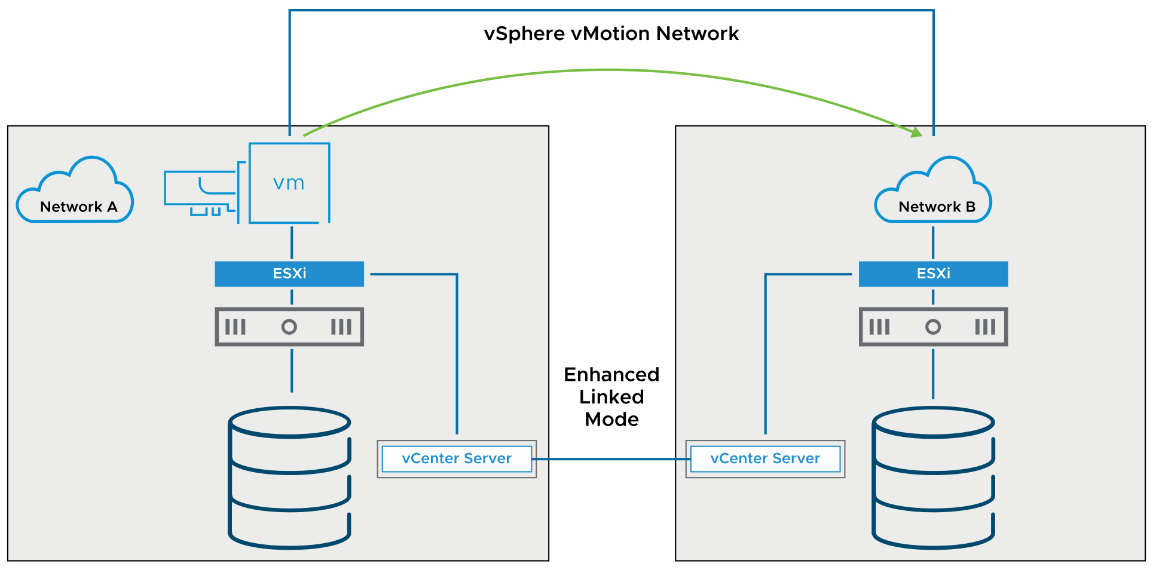
Cross vCenter Migration Requirements
Cross vCenter migrations have the following requirements:
ESXi hosts and vCenter Server systems must be at vSphere 6.0 or later.
vCenter Server instances must be in Enhanced Linked Mode.
Hosts must be time-synchronized.
Notes:
You can perform cross vCenter migrations between vCenter Server instances of different versions. For information on the supported versions, see VMware knowledge base article 2106952 at http://kb.vmware.com/kb/2106952.

Slide 55
Network Checks for Cross vCenter Migrations
vCenter Server performs several network compatibility checks to prevent the following configuration problems:
MAC address incompatibility on the destination host
vSphere vMotion migration from a distributed switch to a standard switch
vSphere vMotion migration between distributed switches of different versions

Slide 56
VMkernel Networking Layer and TCP/IP Stacks
The VMkernel networking layer provides connectivity to hosts and handles the standard system traffic of vSphere vMotion, IP storage, vSphere Fault Tolerance, vSAN, and others.
TCP/IP stacks at the VMkernel level:
Default TCP/IP stack
vSphere vMotion TCP/IP stack
Provisioning TCP/IP stack
Custom TCP/IP stacks
Notes:
Consider the following key points about TCP/IP stacks at the VMkernel level:
Default TCP/IP stack: Provides networking support for the management traffic between vCenter Server and ESXi hosts and for system traffic such as vSphere vMotion, IP storage, and vSphere Fault Tolerance.
vSphere vMotion TCP/IP stack: Supports the traffic for hot migrations of VMs.
Provisioning TCP/IP stack: Supports the traffic for VM cold migration, cloning, and snapshot creation. You can use the provisioning TPC/IP stack to handle NFC traffic during long-distance vSphere vMotion migration. VMkernel adapters configured with the provisioning TCP/IP stack handle the traffic from cloning the virtual disks of the migrated VMs in long-distance vSphere vMotion.
By using the provisioning TCP/IP stack, you can isolate the traffic from the cloning operations on a separate gateway. After you configure a VMkernel adapter with the provisioning TCP/IP stack, all adapters on the default TCP/IP stack are disabled for the provisioning traffic.
Custom TCP/IP stacks: You can create a custom TCP/IP stack on a host to forward networking traffic through a custom application. Open an SSH connection to the host and run the vSphere CLI command:
esxcli network ip netstack add -N="stack_name"
Take appropriate security measures to prevent unauthorized access to the management and system traffic in your vSphere environment. For example, isolate the vSphere vMotion traffic in a separate network that includes only the ESXi hosts that participate in the migration. Isolate the management traffic in a network that only network and security administrators can access.

Slide 57
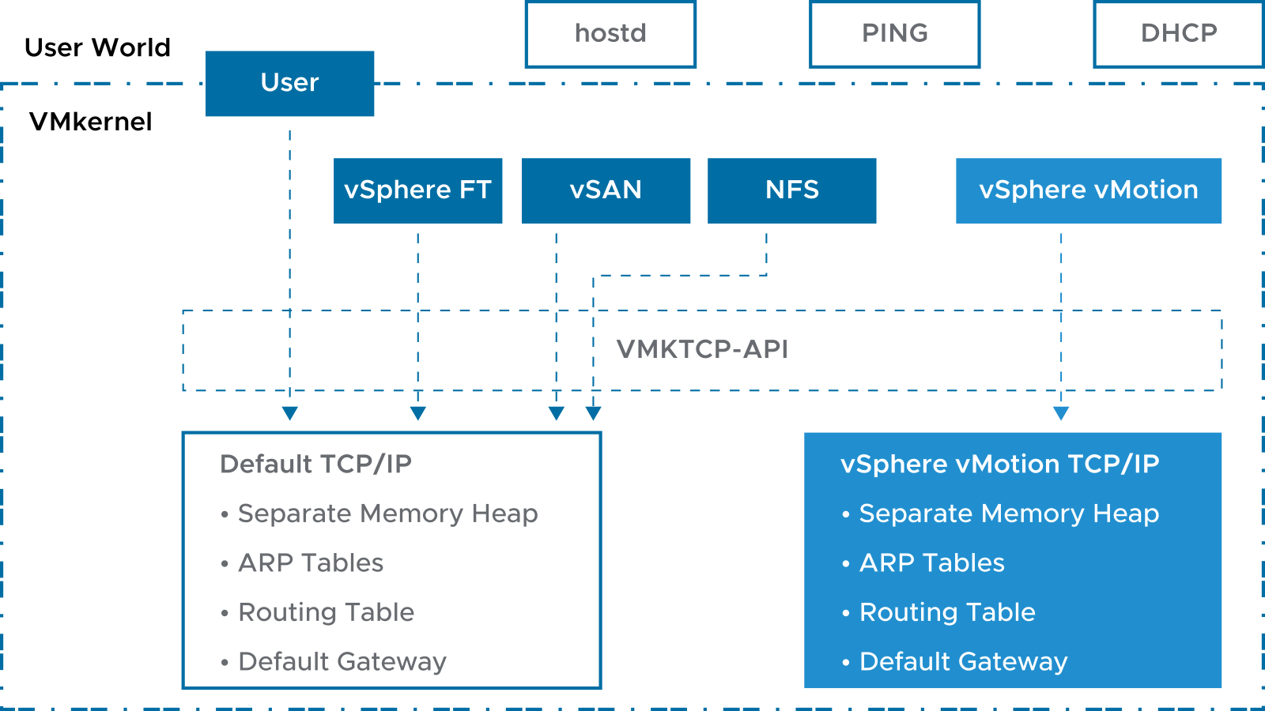
vSphere vMotion TCP/IP Stacks
Each ESXi host has a second TCP/IP stack that is dedicated to vSphere vMotion migration.
Notes:
vSphere vMotion TCP/IP stacks support the traffic for hot migrations of VMs. Use the vSphere vMotion TCP/IP stack to provide better isolation for the vSphere vMotion traffic. After you create a VMkernel adapter on the vSphere vMotion TCP/IP stack, you can use only this stack for vSphere vMotion migration on this host.
The VMkernel adapters on the default TCP/IP stack are disabled for the vSphere vMotion service after you create a VMkernel adapter on the vSphere vMotion TCP/IP stack. If a hot migration uses the default TCP/IP stack while you configure VMkernel adapters with the vMotion TCP/IP stack, the migration completes successfully. However, these VMkernel adapters on the default TCP/IP stack are disabled for future vSphere vMotion sessions.

Slide 58
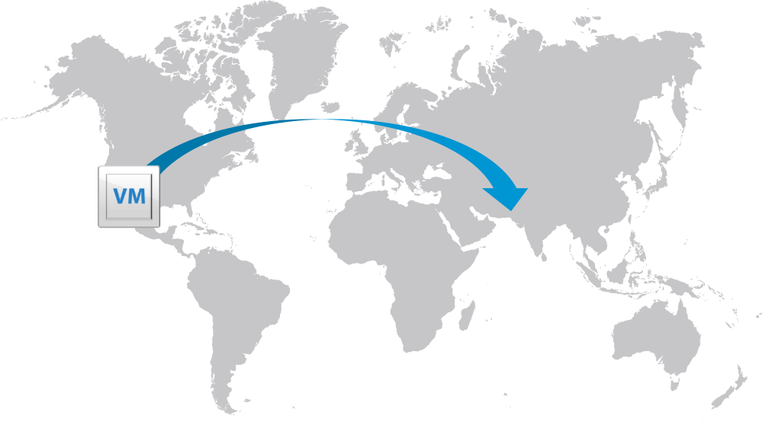
Long-Distance vSphere vMotion Migration
Long-distance vSphere vMotion migration is an extension of cross vCenter migration.
vCenter Server instances are spread across large geographic distances and where the latency across sites is high.
Use cases for long-distance vSphere vMotion migration:
Permanent migrations
Disaster avoidance
Site Recovery Manager and disaster avoidance testing
Multisite load balancing
Follow-the-sun scenario support
Notes:
In the follow-the-sun scenario, a global support team might support a certain set of VMs. As one support team ends their workday, another support team in a different timezone takes over support duty. The VMs being supported can be moved from one geographical location to another so that the support team on duty can access those VMs locally instead of long distance.

Slide 59
Networking Prerequisites for Long-Distance vSphere vMotion
Long-distance vSphere vMotion migrations must connect over layer 3 connections:
Virtual machine network:
L2 connection.
Same VM IP address is available at the destination.
vSphere vMotion network:
L3 connection.
Secure (if you are not using vSphere 6.5 or later encrypted vSphere vMotion).
250 Mbps per vSphere vMotion operation.
Round-trip time between hosts can take up to 150 milliseconds.

Slide 60
Lab 19: vSphere vMotion Migrations
Configure vSphere vMotion networking and migrate virtual machines using vSphere vMotion:
Configure vSphere vMotion Networking on sa-esxi-01.vclass.local
Configure vSphere vMotion Networking on sa-esxi-02.vclass.local
Prepare Virtual Machines for vSphere vMotion Migration
Migrate Virtual Machines Using vSphere vMotion

Slide 61
Review of Learner Objectives
After completing this lesson, you should be able to meet the following objectives:
Recognize the types of VM migrations that you can perform within a vCenter Server instance and across vCenter Server instances
Explain how vSphere vMotion works
Verify vSphere vMotion requirements
Migrate virtual machines using vSphere vMotion

Slide 62
Lesson 5: Enhanced vMotion Compatibility

Slide 63
Learner Objectives
After completing this lesson, you should be able to meet the following objectives:
Describe Enhanced vMotion Compatibility
Configure EVC mode on a vSphere cluster
Explain how per-VM EVC mode works with vSphere vMotion

Slide 64
CPU Constraints on vSphere vMotion Migration
CPU compatibility between source and target hosts is a vSphere vMotion requirement that must be met.
CPU Characteristics | Exact Match Required By Source Host and Target Host | Reason
Clock speeds, cache sizes, hyperthreading, and number of cores | N/A | The VMkernel virtualizes these characteristics.
Manufacturer (Intel or AMD) family and generation (Opteron4, Intel Westmere) | Applicable | Instruction sets contain many small differences.
Presence or absence of SSE3, SSSE3, or SSE4.1 instructions | Applicable | Multimedia instructions are usable directly by applications.
Virtualization hardware assist | For 32-bit VMs: N/A | The VMkernel virtualizes this characteristic.
 | For 64-bit VMs on Intel: Applicable | Intel 64-bit with VMware implementation uses Intel VT.
Notes:
Depending on the CPU characteristic, an exact match between the source and target host might or might not be required. For example, if hyperthreading is enabled on the source host and disabled on the destination host, the vSphere vMotion migration continues because the VMkernel handles this difference in characteristics. But, if the source host processor supports SSE4.1 instructions and the destination host processor does not support them, the hosts are considered incompatible and the vSphere vMotion migration fails. SSE4.1 instructions are application-level instructions that bypass the virtualization layer and might cause application instability if mismatched after a migration with vSphere vMotion.

Slide 65
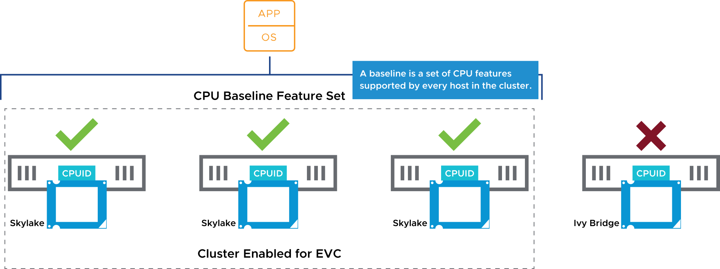
About Enhanced vMotion Compatibility
Enhanced vMotion Compatibility is a cluster feature that prevents vSphere vMotion migrations from failing because of incompatible CPUs.
This feature works at the cluster level, using CPU baselines to configure all processors in the cluster that are enabled for Enhanced vMotion Compatibility.
Notes:
Enhanced vMotion Compatibility ensures that all hosts in a cluster present the same CPU feature set to VMs, even if the CPUs on the hosts differ.
Enhanced vMotion Compatibility facilitates safe vSphere vMotion migration across a range of CPU generations. With Enhanced vMotion Compatibility, you can use vSphere vMotion to migrate VMs among CPUs that otherwise are considered incompatible.
Enhanced vMotion Compatibility allows vCenter Server to enforce vSphere vMotion compatibility among all hosts in a cluster by forcing hosts to expose a common set of CPU features (baseline) to VMs. A baseline is a set of CPU features that are supported by every host in the cluster. When you configure Enhanced vMotion Compatibility, you set all host processors in the cluster to present the features of a baseline processor. After the features are enabled for a cluster, hosts that are added to the cluster are automatically configured to the CPU baseline.
Hosts that cannot be configured to the baseline are not permitted to join the cluster. VMs in the cluster always see an identical CPU feature set, no matter which host they happen to run on. Because this process is automatic, Enhanced vMotion Compatibility is easy to use and requires no specialized knowledge of CPU features and masks.

Slide 66
Enhanced vMotion Compatibility Cluster Requirements
All hosts in the cluster must meet several requirements:
Use CPUs from a single vendor, either Intel or AMD:
Use Intel CPUs with Merom microarchitecture and later.
Use AMD first-generation Opteron CPUs and later.
Be enabled for hardware virtualization: AMD-V or Intel VT.
Be enabled for execution-disable technology: AMD No eXecute (NX) or Intel eXecute Disable (XD).
Be configured for vSphere vMotion migration.
Applications in VMs must be CPU ID compatible.
Notes:
Before you create an Enhanced vMotion Compatibility cluster, ensure that the hosts that you intend to add to the cluster meet the requirements.
Enhanced vMotion Compatibility automatically configures hosts whose CPUs have Intel FlexMigration and AMD-V Extended Migration technologies to be compatible with vSphere vMotion with hosts that use older CPUs.
For Enhanced vMotion Compatibility to function properly, the applications on the VMs must be written to use the CPU ID machine instruction for discovering CPU features as recommended by the CPU vendors. vSphere cannot support Enhanced vMotion Compatibility with applications that do not follow the CPU vendor recommendations for discovering CPU features.
To determine which EVC modes are compatible with your CPU, search the VMware Compatibility Guide at http://www.vmware.com/resources/compatibility. Search for the server model or CPU family, and click the entry in the CPU Series column to display the compatible EVC modes.

Slide 67
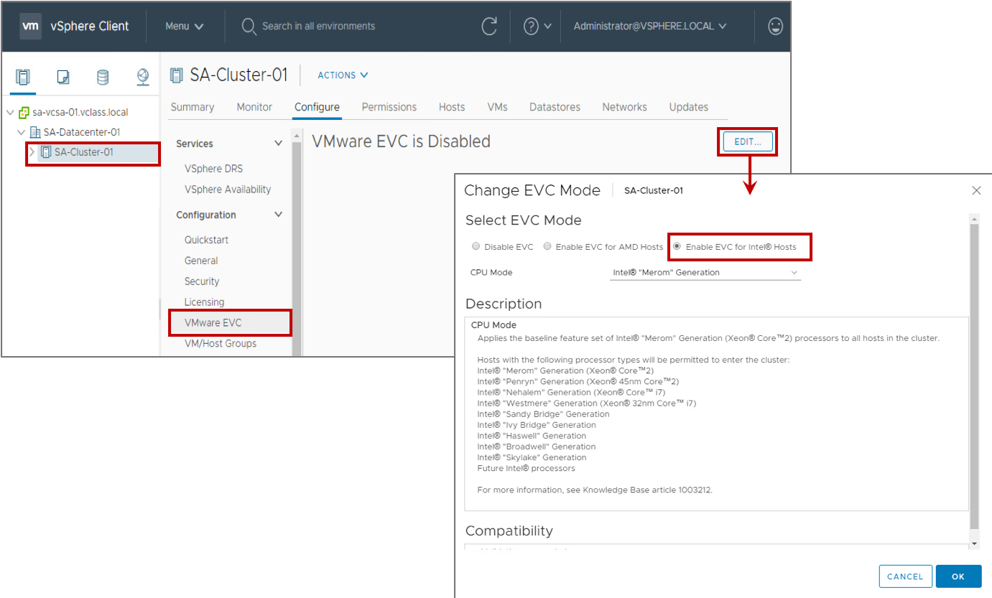
Enabling EVC Mode on an Existing Cluster
You enable EVC mode on an existing cluster to ensure vSphere vMotion CPU compatibility between the hosts in the cluster.
Notes:
You can use one of the following methods to create an Enhanced vMotion Compatibility cluster:
Create an empty cluster with EVC mode enabled and move hosts into the cluster.
Enable EVC mode on an existing cluster.
For information about Enhanced vMotion Compatibility processor support, see VMware knowledge base article 1003212 at http://kb.vmware.com/kb/1003212.

Slide 68
Changing the EVC Mode for a Cluster
Several EVC mode approaches are available to ensure CPU compatibility:
If all the hosts in a cluster are compatible with a newer EVC mode, you can change the EVC mode of an existing Enhanced vMotion Compatibility cluster.
You can enable EVC mode for a cluster that does not have EVC mode enabled.
You can raise or lower the EVC mode, but the VMs must be in the correct power state to do so.
EVC Mode | VM Power Action
Raise the EVC mode to a CPU baseline with more features. | Running VMs can remain powered on. New EVC mode features are not available to the VMs until they are powered off and powered back on again (Suspending and resuming the VM is not sufficient.)
Lower the EVC mode to a CPU baseline with fewer features. | Power off VMs if they are powered on and running at a higher EVC mode than the one you intend to enable.

Slide 69
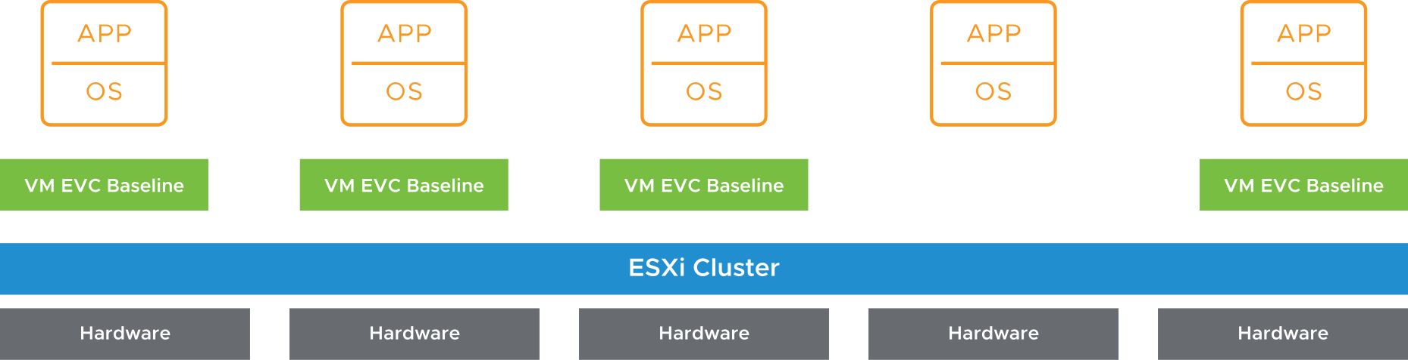
Virtual Machine EVC Mode
EVC mode can be applied to some or all VMs in a cluster:
At the VM level, EVC mode facilitates the migration of VMs beyond the cluster and across vCenter Server systems and data centers.
You can apply more granular definitions of Enhanced vMotion Compatibility for specific VMs.
VM EVC mode is independent of the EVC mode defined at the cluster level.
VM EVC mode requires vSphere 6.7 or later.
Notes:
With per-VM EVC mode, the EVC mode becomes an attribute of the VM rather than the specific processor generation it happens to be booted on in the cluster. This feature supports seamless migration between two data centers that have different processors. Further, the feature is persisted per VM and does not lose the EVC mode during migrations across clusters or during power cycles.
In this diagram, EVC mode is not enabled on the cluster. The cluster consists of differing CPU models with different feature sets. The VMs with per-VM EVC mode can run on any ESXi host that can satisfy the defined EVC mode.

Slide 70
Review of Learner Objectives
After completing this lesson, you should be able to meet the following objectives:
Describe Enhanced vMotion Compatibility
Configure EVC mode on a vSphere cluster
Explain how per-VM EVC mode works with vSphere vMotion

Slide 71
Lesson 6: Migrating VMs with vSphere Storage vMotion

Slide 72
Learner Objectives
After completing this lesson, you should be able to meet the following objectives:
Explain how vSphere Storage vMotion works
Recognize guidelines for using vSphere Storage vMotion
Migrate virtual machines using vSphere Storage vMotion
Migrate both the compute resource and storage of a virtual machine

Slide 73
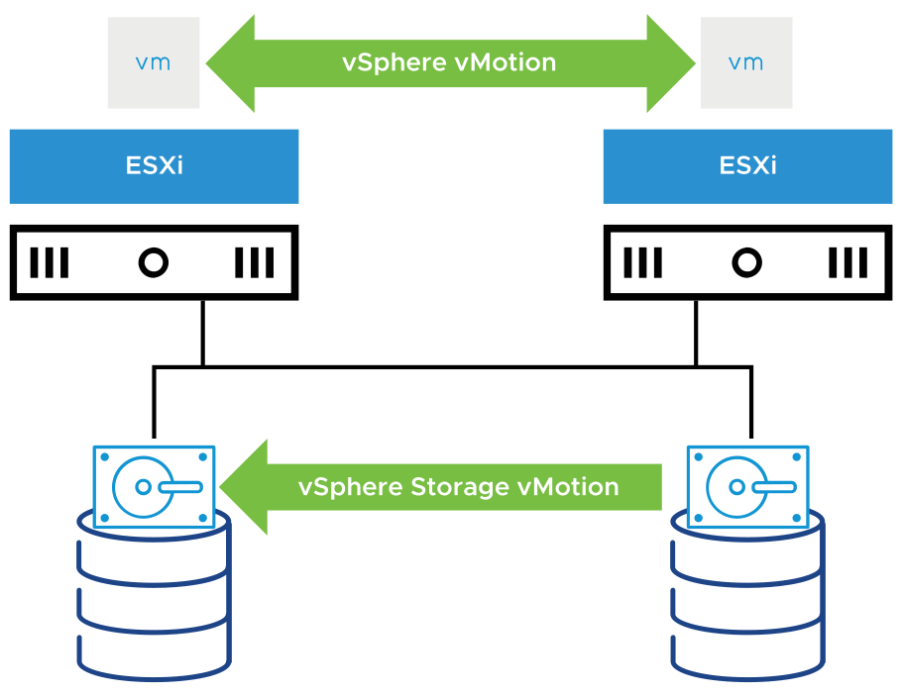
About vSphere Storage vMotion
With vSphere Storage vMotion, you can migrate a powered-on VM from one datastore to another.
Using vSphere Storage vMotion, you can perform the following tasks:
Move VMs off arrays for maintenance or to upgrade.
Change the disk provisioning type.
Change VM files on the destination datastore to match the inventory name of the VM.
Migrate between datastores to balance traffic across storage paths and reduce latencies.
Redistribute VMs or virtual disks to different storage volumes to balance capacity or improve performance.
Notes:
vSphere Storage vMotion provides flexibility to optimize disks for performance or transform disk types, which you can use to reclaim space.
You can place the VM and all its disks in a single location, or you can select separate locations for the VM configuration file and each virtual disk. During a migration with vSphere Storage vMotion, the VM does not change the host that it runs on.
With vSphere Storage vMotion, you can rename a VM's files on the destination datastore. The migration renames all virtual disk, configuration, snapshot, and .nvram files.

Slide 74
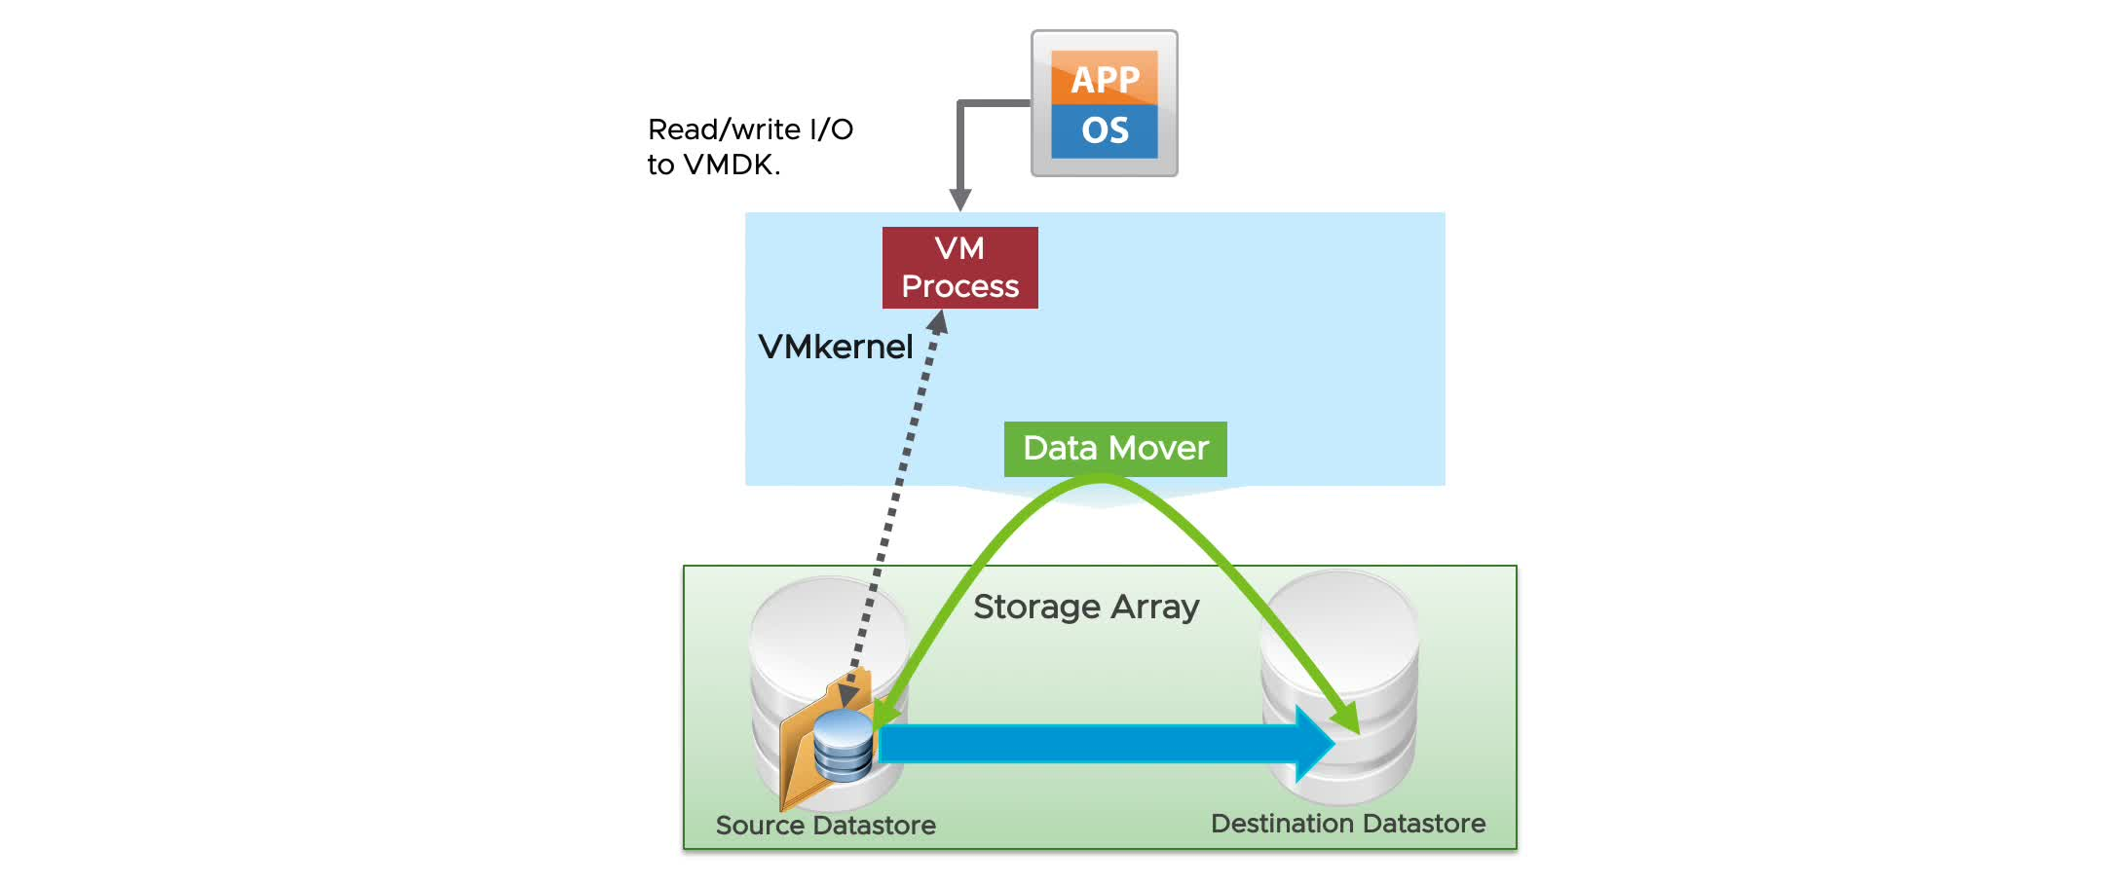
vSphere Storage vMotion In Action
vSphere Storage vMotion uses an I/O mirroring architecture to copy disk blocks between the source and destination.
Notes:
To play the animation, go to https://vmware.bravais.com/s/FnHZwq043PJ8dV3ZRV7p.
The vSphere Storage vMotion migration process includes the following steps:
Initiate storage migration.
Use the VMkernel data mover or vSphere Storage APIs - Array Integration to copy data.
Start a new VM process.
Mirror I/O calls to file blocks that are already copied to the virtual disk on the destination datastore.
Transition to the destination VM process to begin accessing the virtual disk copy.
The storage migration process does a single pass of the disk, copying all the blocks to the destination disk. If blocks are changed after they are copied, the blocks are synchronized from the source to the destination through the mirror driver, with no need for recursive passes.
This approach guarantees complete transactional integrity and is fast enough to be unnoticeable to the end user. The mirror driver uses the VMkernel data mover to copy blocks of data from the source disk to the destination disk. The mirror driver synchronously mirrors writes to both disks during the vSphere Storage vMotion operation.
Finally, vSphere Storage vMotion operations are performed either internally on a single ESXi host or offloaded to the storage array. Operations performed internally on the ESXi host use a data mover built into the VMkernel. Operations are offloaded to the storage array if the array supports vSphere Storage APIs - Array Integration, also called hardware acceleration.

Slide 75
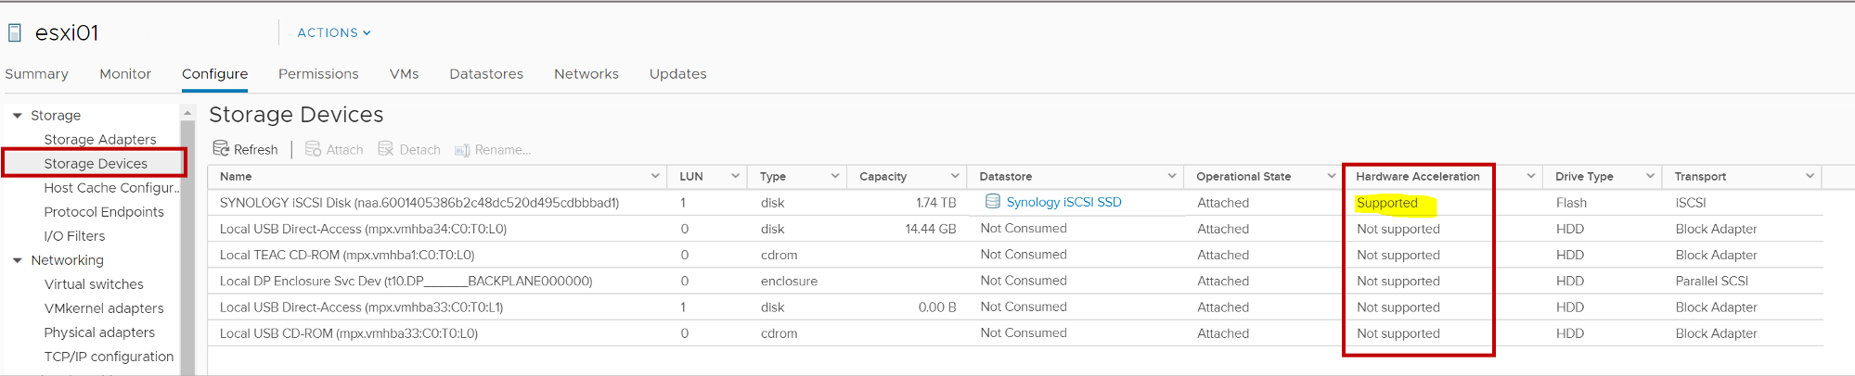
Identifying Storage Arrays That Support vSphere Storage APIs - Array Integration
vSphere Storage vMotion offloads its operations to the storage array if the array supports VMware vSphere Storage APIs - Array Integration, also called hardware acceleration.
Use the vSphere Client to determine whether your storage array supports hardware acceleration.

Slide 76
vSphere Storage vMotion Guidelines and Limitations
Guidelines:
Plan the migration and coordinate with administrators.
Perform migrations during off-peak hours.
Limitation:
Independent virtual machine disks must be in persistent mode.
Notes:
A VM and its host must meet certain resource and configuration requirements for the virtual machine disks (VMDKs) to be migrated with vSphere Storage vMotion. One of the requirements is that the host on which the VM runs must have access both to the source datastore and to the target datastore.
During a migration with vSphere Storage vMotion, you can change the disk provisioning type. Migration with vSphere Storage vMotion changes VM files on the destination datastore to match the inventory name of the VM. The migration renames all virtual disk, configuration, snapshot, and .nvram-extension files. If the new names exceed the maximum filename length, the migration does not succeed.

Slide 77
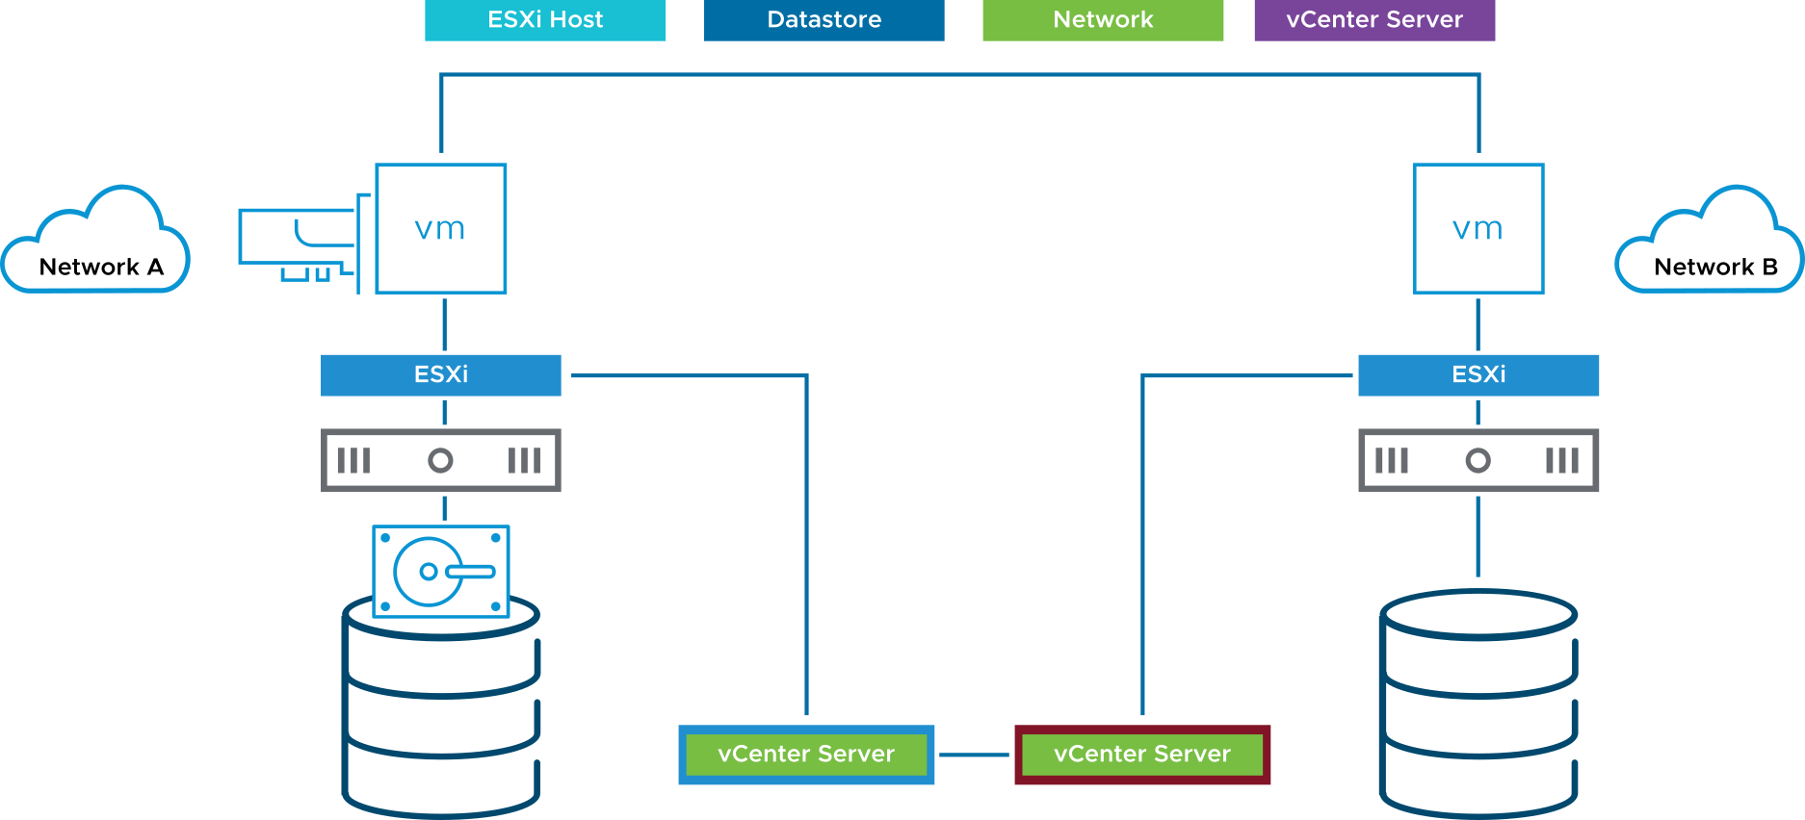
Changing Both Compute Resource and Storage During Migration (1)
When you change both compute resource and storage during migration, a VM changes its host, datastores, networks, and vCenter Server instances simultaneously:
This technique combines vSphere vMotion and vSphere Storage vMotion into a single operation.
You can migrate VMs across clusters, data centers, and vCenter Server instances.
Notes:
You can migrate VMs beyond storage accessibility boundaries and between hosts, within and across clusters, data centers, and vCenter Server instances.
This type of migration is useful for performing cross-cluster migrations, when the target cluster VMs might not have access to the source cluster’s storage. Processes on the VM continue to run during the migration with vSphere vMotion.

Slide 78
Changing Both Compute Resource and Storage During Migration (2)
Compute resource and storage migration is useful for virtual infrastructure administration tasks.
Task | Benefit of Using vSphere Storage vMotion
Host maintenance | You can move VMs from a host when you want to perform host maintenance.
Storage maintenance and reconfiguration | You can move VMs from a storage device so that you can perform maintenance or reconfigure the storage device without VM downtime.
Storage load redistribution | You can manually redistribute VMs or virtual disks to different storage volumes to balance capacity or to improve performance.

Slide 79
Lab 20: vSphere Storage vMotion Migrations
Use vSphere Storage vMotion to migrate virtual machines:
Migrate Virtual Machine Files from Local Storage to Shared Storage
Migrate Both the Compute Resource and Storage of a Virtual Machine

Slide 80
Review of Learner Objectives
After completing this lesson, you should be able to meet the following objectives:
Explain how vSphere Storage vMotion works
Recognize guidelines for using vSphere Storage vMotion
Migrate virtual machines using vSphere Storage vMotion
Migrate both the compute resource and storage of a virtual machine

Slide 81
Lesson 7: Creating Virtual Machine Snapshots

Slide 82
Learner Objectives
After completing this lesson, you should be able to meet the following objectives:
Take a snapshot of a virtual machine
Manage multiple snapshots
Delete virtual machine snapshots
Consolidate snapshots

Slide 83
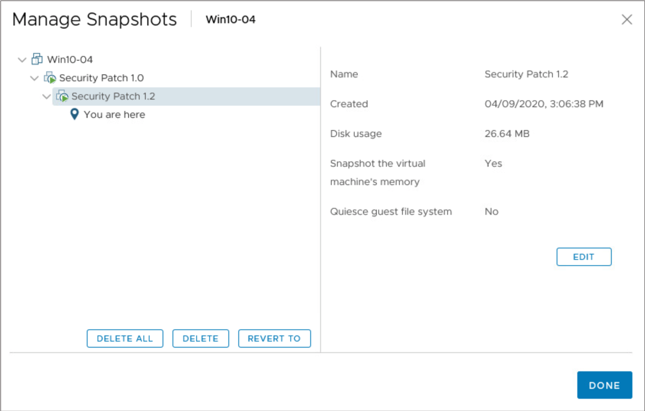
VM Snapshots
With snapshots, you can preserve the state of the VM so that you can repeatedly return to the same state.
For example, if problems occur during the patching or upgrading process, you can stop the process and revert to the previous state.
VM snapshots are not recommended as a VM backup strategy.
Notes:
Snapshots are useful when you want to revert repeatedly to the same state but do not want to create multiple VMs. Examples include patching or upgrading the guest operating system in a VM.
The relationship between snapshots is like the relationship between a parent and a child. Snapshots are organized in a snapshot tree. In a snapshot tree, each snapshot has one parent and one or more children, except for the last snapshot, which has no children.

Slide 84
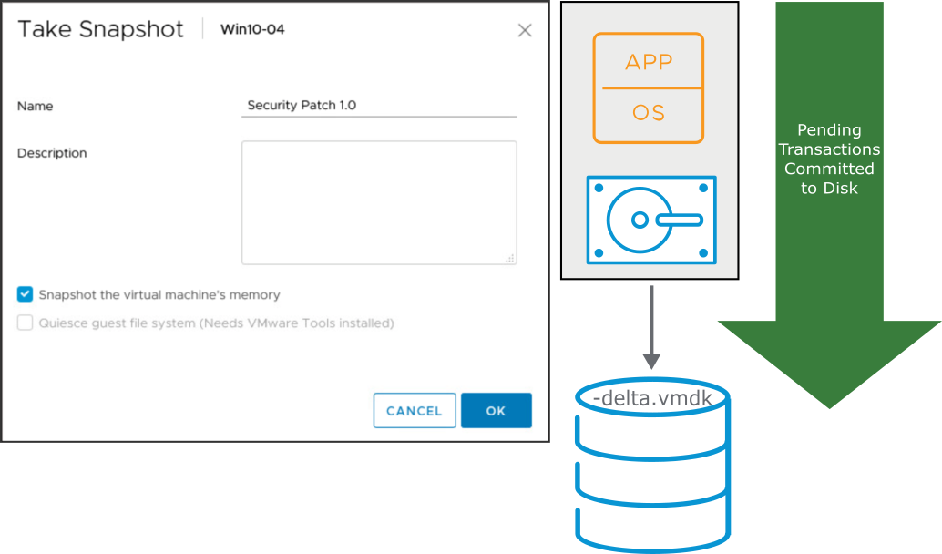
Taking Snapshots
You can take a snapshot while a VM is powered on, powered off, or suspended.
A snapshot captures the following items:
VM configuration
VM memory state (optional)
Virtual disks
A snapshot capture does not include Independent virtual disks (persistent and nonpersistent).
Notes:
A snapshot captures the entire state of the VM at the time that you take the snapshot, including the following states:
Memory state: The contents of the VM’s memory. The memory state is captured only if the VM is powered on and if you select the Snapshot the virtual machine’s memory check box (selected by default).
Settings state: The VM settings.
Disk state: The state of all the VM’s virtual disks.
At the time that you take the snapshot, you can also quiesce the guest operating system. This action quiesces the file system of the guest operating system. This option is available only if you do not capture the memory state as part of the snapshot.

Slide 85
Types of Snapshots
A delta or child disk is created when you create a snapshot:
On the VMFS datastore, the delta disk is a sparse disk.
Delta disks use different sparse formats depending on the type of datastore.
Snapshot Type | Notes | Filename | Block Size
VMFSsparse | VMFS5 with virtual disks smaller than 2 TB | #-delta.vmdk | 512 bytes
SEsparse | VMFS6 VMFS5 with virtual disks larger than 2 TB Space efficient (thin provisioned) Supports disk reclamation (unmap) | #-sesparse.vmdk | 4 KB
vsanSparse | vSAN | Delta object | 4 MB
Notes:
Delta disks use different sparse formats depending on the type of datastore.
VMFSsparse: VMFS5 uses the VMFSsparse format for virtual disks smaller than 2 TB. VMFSsparse is implemented on top of VMFS. The VMFSsparse layer processes I/O operations issued to a snapshot VM. Technically, VMFSsparse is a redo log that starts empty, immediately after a VM snapshot is taken. The redo log expands to the size of its base VMDK, when the entire VMDK is rewritten with new data after the VM snapshot. This redo log is a file in the VMFS datastore. On snapshot creation, the base VMDK attached to the VM is changed to the newly created sparse VMDK.
SEsparse: SEsparse is a default format for all delta disks on the VMFS6 datastores. On VMFS5, SEsparse is used for virtual disks of the size 2 TB and larger. SEsparse is a format that is like VMFSsparse with some enhancements. This format is space efficient and supports the space-reclamation technique. With space reclamation, blocks that the guest OS deletes are marked. The system sends commands to the SEsparse layer in the hypervisor to unmap those blocks. The unmapping helps to reclaim space allocated by SEsparse after the guest operating system deletes the data.

Slide 86
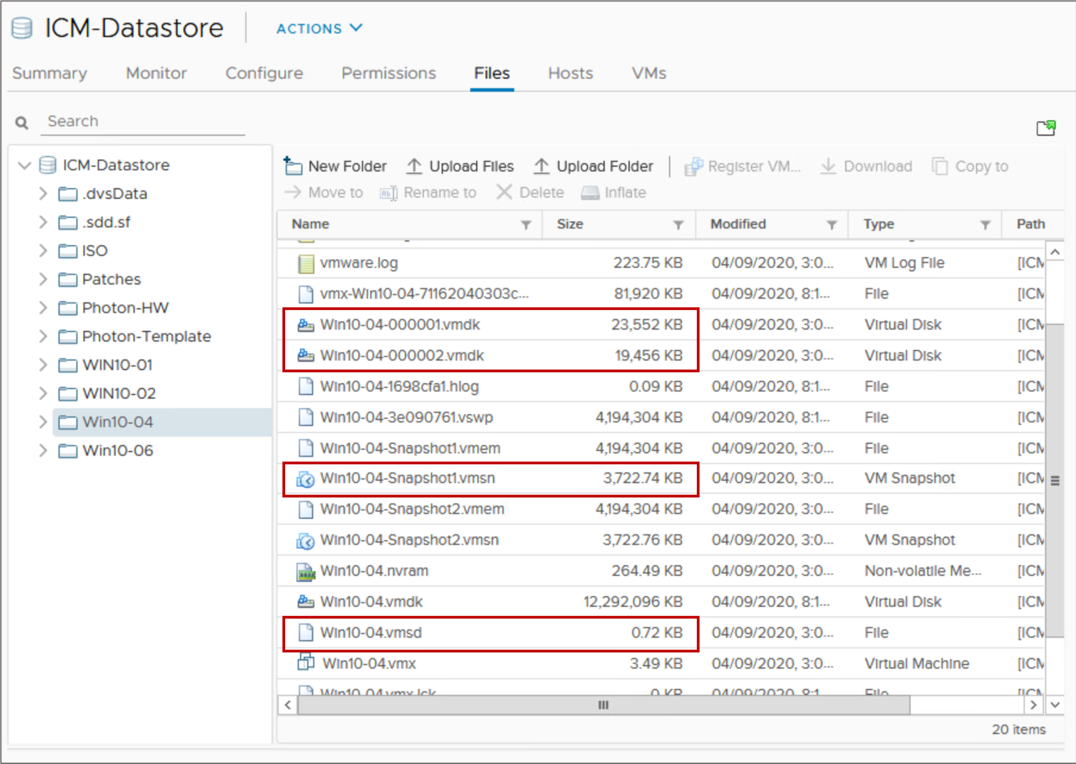
VM Snapshot Files
A snapshot consists of a set of files:
-Snapshot#.vmsn: Configuration state
-Snapshot#.vmem: Memory state (optional)
-00000#.vmdk: Disk descriptor
-00000#-delta.vmdk: VMFS5 delta
-00000#-sesparse.vmdk: VMFS6 delta
.vmsd: Stores names, descriptions, and relationships for all the VM's snapshots
Notes:
A VM can have one or more snapshots. For each snapshot, the following files are created:
Snapshot delta file: This file contains the changes to the virtual disk’s data since the snapshot was taken. When you take a snapshot of a VM, the state of each virtual disk is preserved. The VM stops writing to its -flat.vmdk file. Writes are redirected to >-######-delta.vmdk (or -######-sesparse.vmdk) instead (for which ###### is the next number in the sequence). You can exclude one or more virtual disks from a snapshot by designating them as independent disks. Configuring a virtual disk as independent is typically done when the virtual disk is created, but this option can be changed whenever the VM is powered off.
Disk descriptor file: -00000#.vmdk. This file is a small text file that contains information about the snapshot.
Configuration state file: -.vmsn. # is the next number in the sequence, starting with 1. This file holds the active memory state of the VM at the point that the snapshot was taken, including virtual hardware, power state, and hardware version.
Memory state file: -.vmem. This file is created if the option to include memory state was selected during the creation of the snapshot. It contains the entire contents of the VMs at the time that the snapshot of the VM was taken.
Snapshot active memory file: -.vmem. This file contains the contents of the VM memory if the option to include memory is selected during the creation of the snapshot.
The .vmsd file is the snapshot list file and is created at the time that the VM is created. It maintains snapshot information for a VM so that it can create a snapshot list in the vSphere Client. This information includes the name of the snapshot .vmsn file and the name of the virtual disk file.
The snapshot state file has a .vmsn extension and is used to store the state of a VM when a snapshot is taken. A new .vmsn file is created for every snapshot that is created on a VM and is deleted when the snapshot is deleted. The size of this file varies, based on the options selected when the snapshot is created. For example, including the memory state of the VM in the snapshot increases the size of the .vmsn file.
You can exclude one or more of the VMDKs from a snapshot by designating a virtual disk in the VM as an independent disk. Placing a virtual disk in independent mode is typically done when the virtual disk is created. If the virtual disk was created without enabling independent mode, you must power off the VM to enable it.
Other files might also exist, depending on the VM hardware version. For example, each snapshot of a VM that is powered on has an associated _.vmem file, which contains the guest operating system main memory, saved as part of the snapshot.

Slide 87
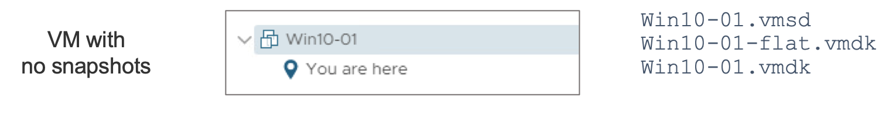
VM Snapshot Files Example (1)
Notes:
This example shows the snapshot and virtual disk files that are created when a VM has no snapshots, one snapshot, and two snapshots.

Slide 88
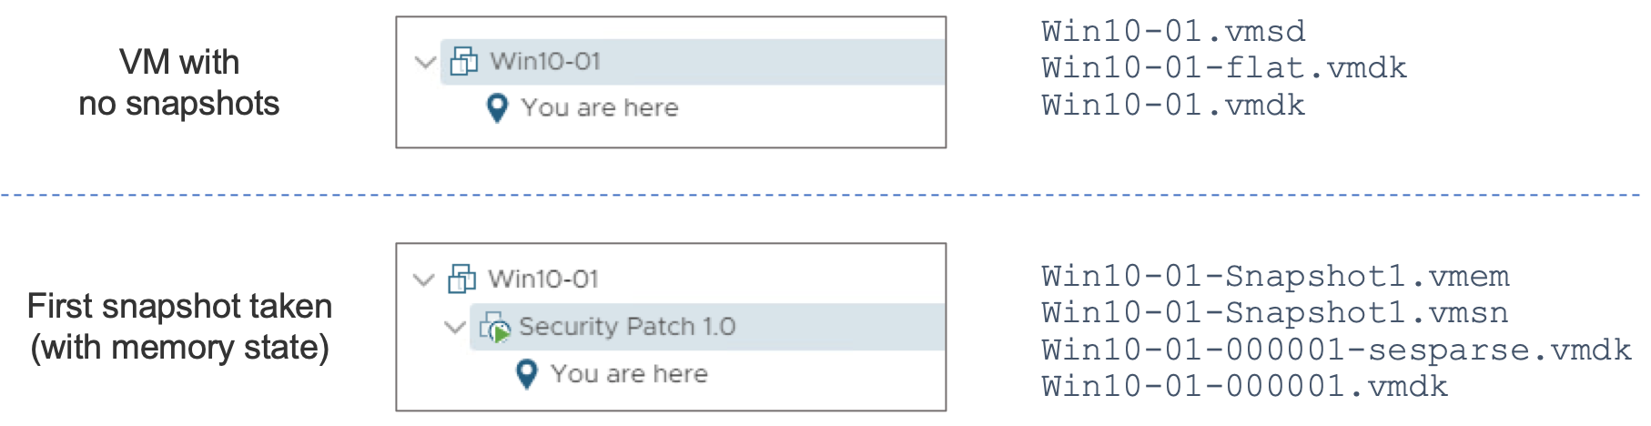
VM Snapshot Files Example (2)

Slide 89
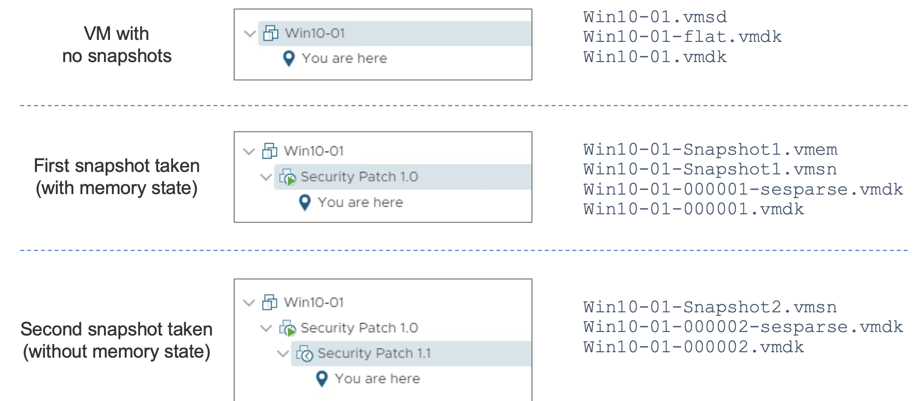
VM Snapshot Files Example (3)

Slide 90
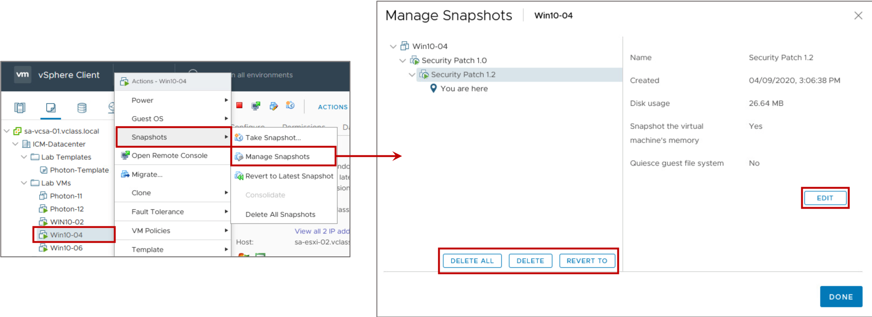
Managing Snapshots
In the vSphere Client, you can view snapshots for the active VM and take edit, delete, and revert to actions.
Notes:
You can perform the following actions from the Manage Snapshots window:
Edit the snapshot: Edit the snapshot name and description.
Delete the snapshot: Remove the snapshot from the Snapshot Manager, consolidate the snapshot files to the parent snapshot disk, and merge with the VM base disk.
Delete all snapshots: Commit all the intermediate snapshots before the current-state icon (You are here) to the VM and remove all snapshots for that VM.
Revert to a snapshot: Restore, or revert to, a particular snapshot. The snapshot that you restore becomes the current snapshot.
When you revert to a snapshot, you return all these items to the state that they were in at the time that you took the snapshot. If you want the VM to be suspended, powered on, or powered off when you start it, ensure that the VM is in the correct state when you take the snapshot.
Deleting a snapshot (DELETE or DELETE ALL) consolidates the changes between snapshots and previous disk states. Deleting a snapshot also writes to the parent disk all data from the delta disk that contains the information about the deleted snapshot. When you delete the base parent snapshot, all changes merge with the base VMDK.

Slide 91
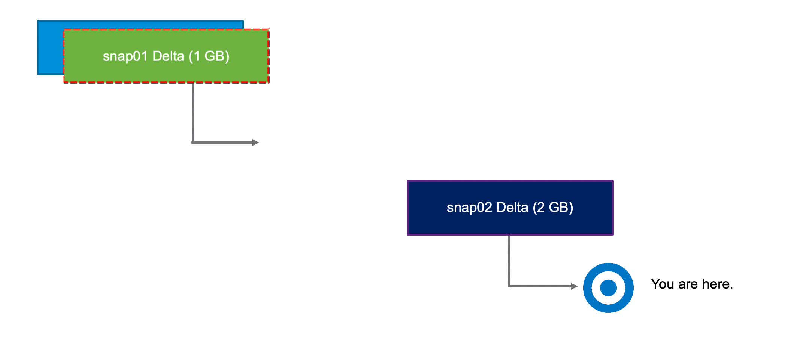
Deleting VM Snapshots (1)
If you delete a snapshot one or more levels above the You are here level, the snapshot state is deleted. In this example, the snap01 data is committed into the parent (base disk), and the foundation for snap02 is retained.
Notes:
To play the animation, go to https://vmware.bravais.com/s/WhbcXR4sSwk2Vl7MeaXD.

Slide 92
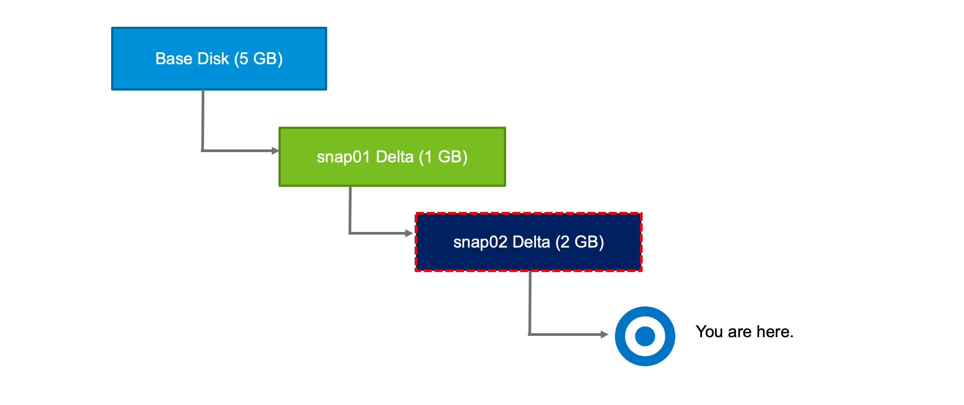
Deleting VM Snapshots (2)
If you delete the latest snapshot, the changes are committed to its parent. The snap02 data is committed into snap01 data, and the snap02 -delta.vmdk file is deleted.
Notes:
To play the animation, go to https://vmware.bravais.com/s/l0JYYQzMTv7pvxBqNcQp.

Slide 93
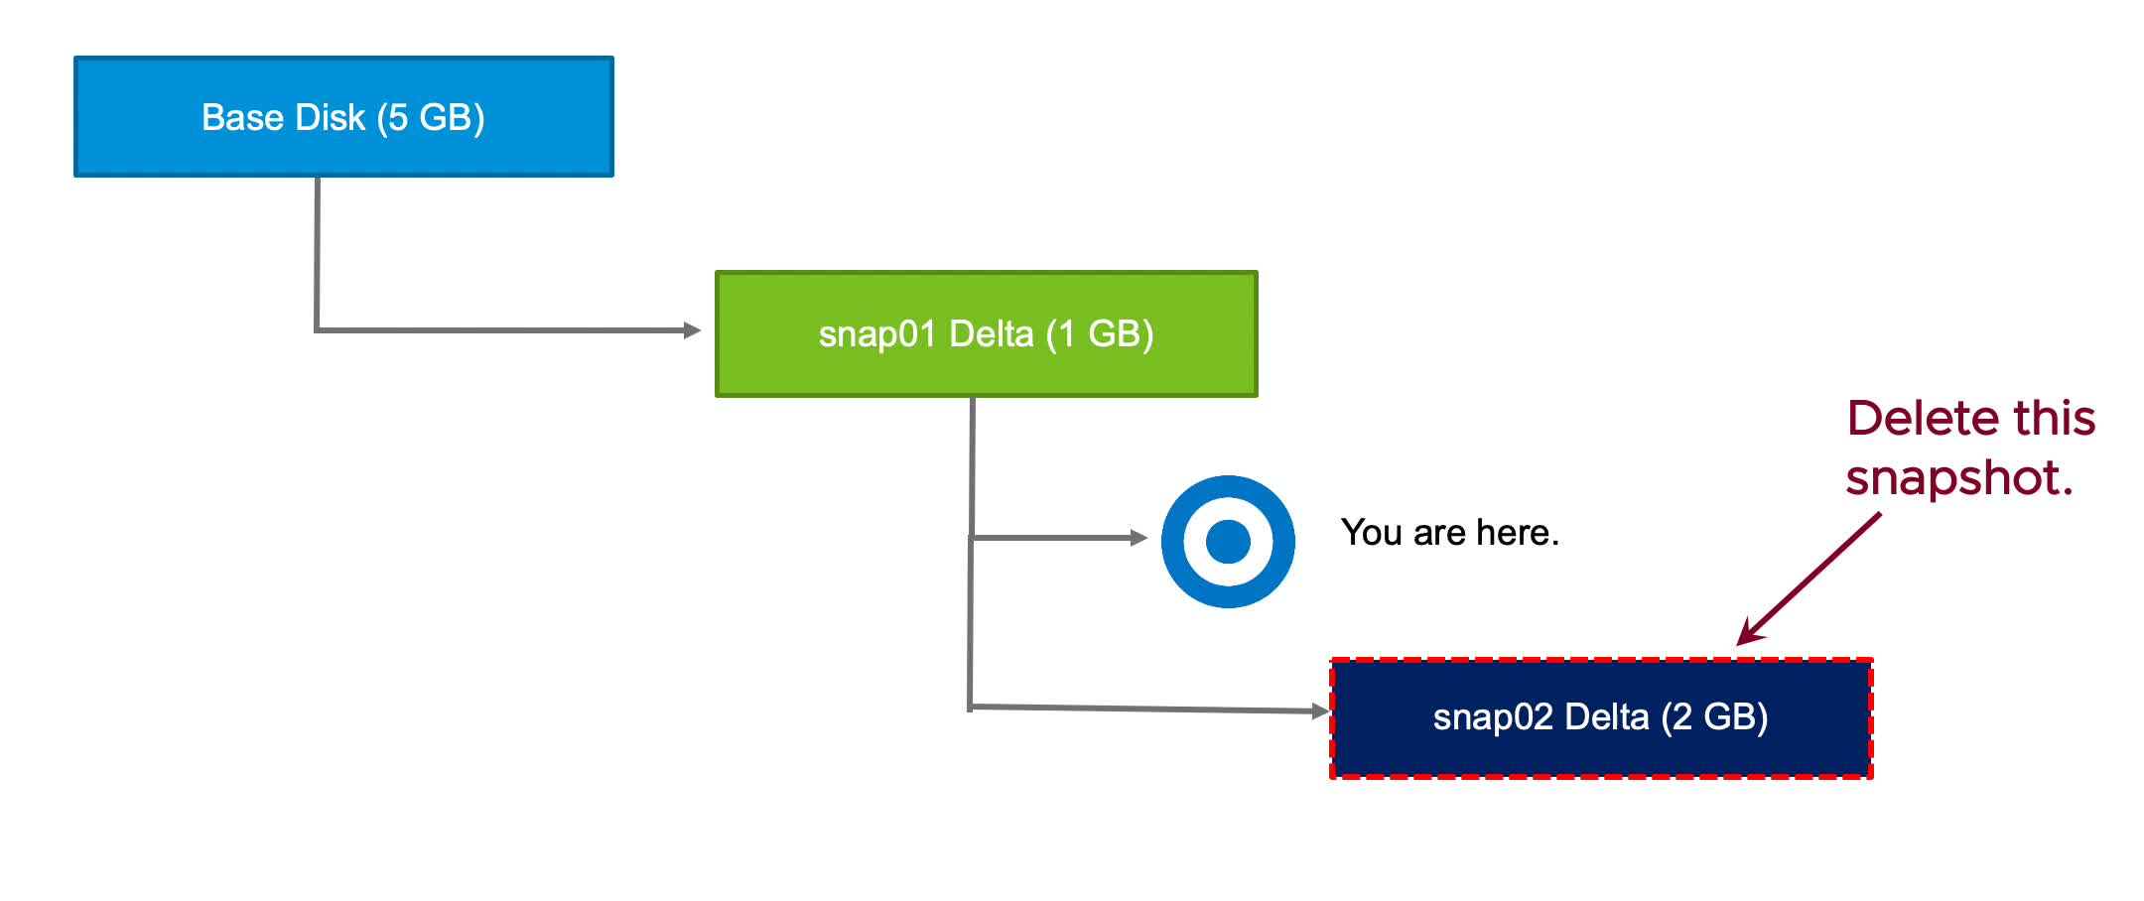
Deleting VM Snapshots (3)
If you delete a snapshot one or more levels below the You are here level, subsequent snapshots are deleted, and you can no longer return to those states. The snap02 data is deleted.
Notes:
To play the animation, go to https://vmware.bravais.com/s/NiQxPT3iycemQ8WYXKom.

Slide 94
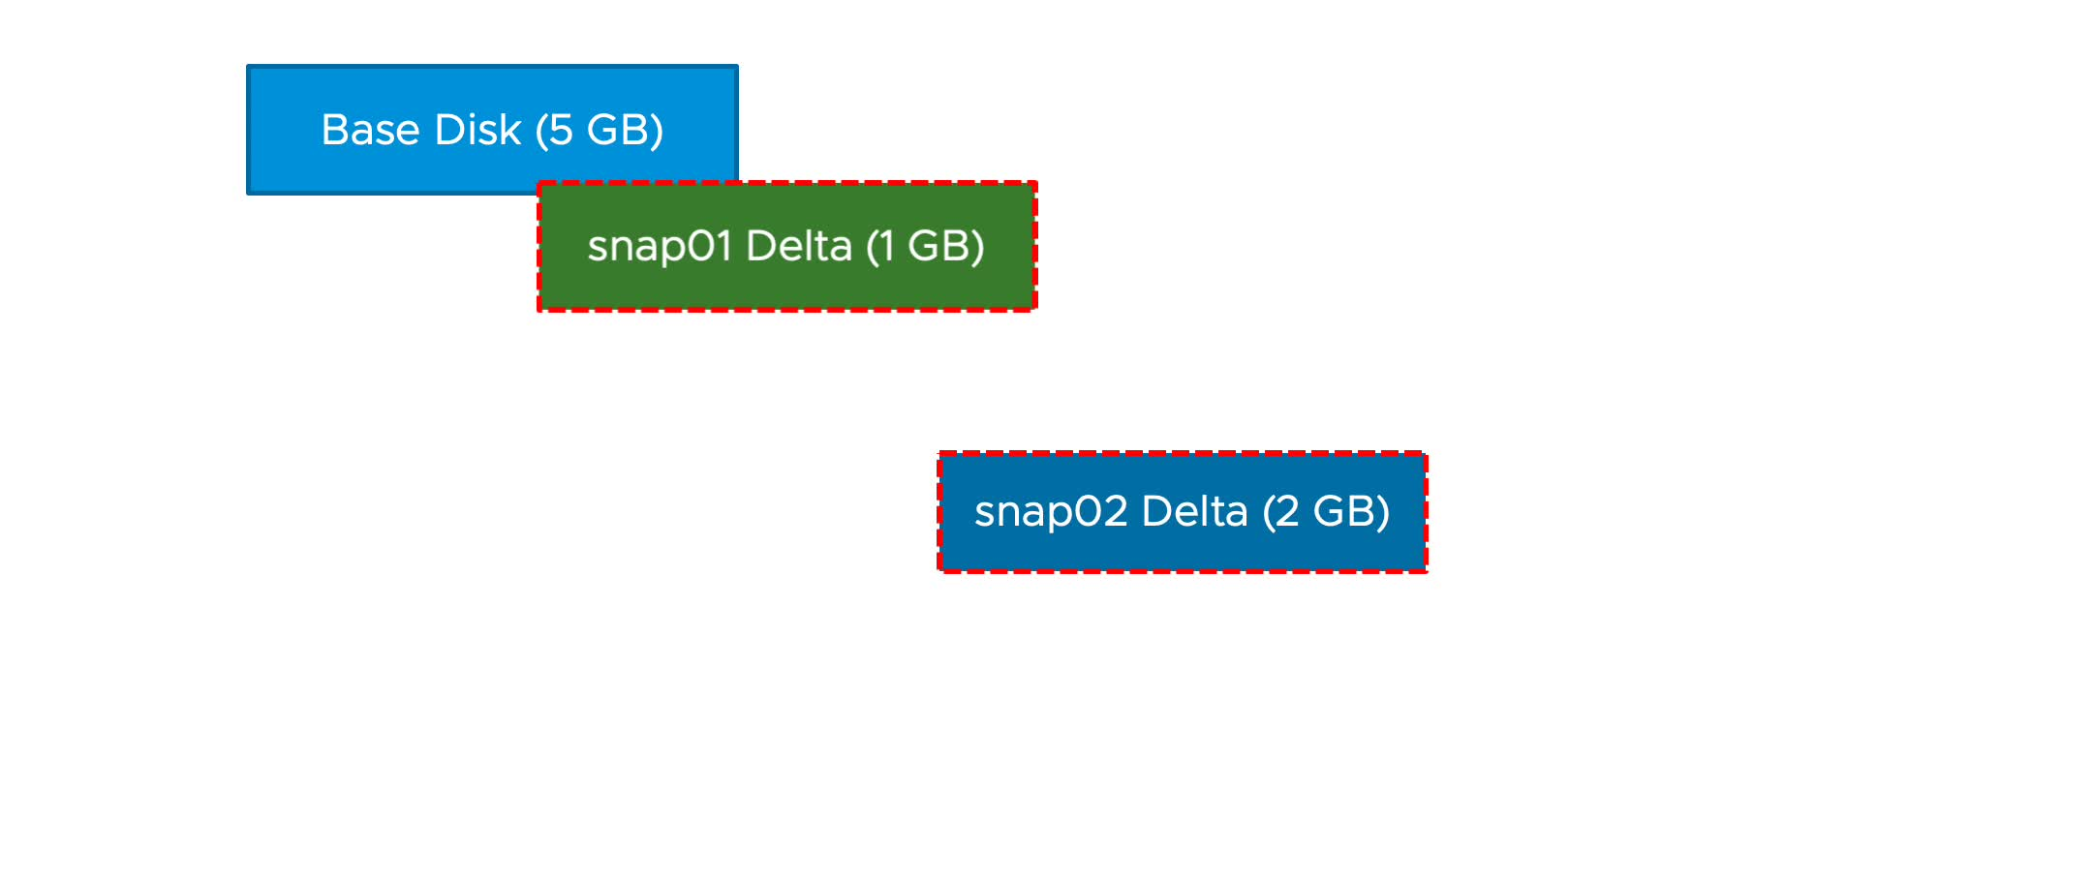
Deleting All VM Snapshots
The delete-all-snapshots mechanism uses storage space efficiently. The size of the base disk does not increase. Snap01 is committed to the base disk before snap02 is committed.
Notes:
To play the animation, go to https://vmware.bravais.com/s/L3ilQHlrywEhIgr5p7RP.
All snapshots before the You are here point are committed all the way up to the base disk. All snapshots after You are here are discarded.
Like a single snapshot deletion, changed blocks in the snapshot overwrite their counterparts in the base disk.

Slide 95
About Snapshot Consolidation
Snapshot consolidation is a method for committing a chain of delta disks to the base disks when the Snapshot Manager shows that no snapshots exist but the delta disk files remain on the datastore.
Snapshot consolidation resolves problems that might occur with snapshots:
The snapshot descriptor file is committed correctly, and the Snapshot window shows that all the snapshots are deleted.
The snapshot files (-delta.vmdk) are still part of the VM.
Delta disk files continue to expand until the datastore on which the VM is located runs out of space.
Notes:
Snapshot consolidation is a way to clean unneeded delta disk files from a datastore. If no snapshots are registered for a VM, but delta disk files exist, snapshot consolidation commits the chain of the delta disk files and removes them.
If consolidation is not performed, the delta disk files might expand to the point of consuming all the remaining space on the VM’s datastore or the delta disk file reaches its configured size. The delta disk cannot be larger than the size configured for the base disk.

Slide 96
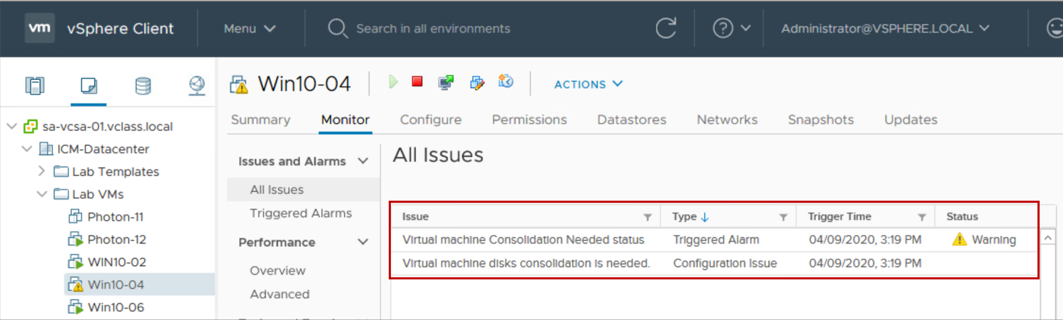
Discovering When to Consolidate Snapshots
On the Monitor tab under All Issues for the VM, a warning notifies you that a consolidation is required.
Notes:
With snapshot consolidation, vCenter Server displays a warning when the descriptor and the snapshot files do not match. After the warning displays, you can use the vSphere Client to commit the snapshots.

Slide 97

Consolidating Snapshots
After the snapshot consolidation warning appears, you can use the vSphere Client to consolidate the snapshots.
All snapshot delta disks are committed to the base disks.
Notes:
For a list of best practices for using snapshots in a vSphere environment, see VMware knowledge base article 1025279 at http://kb.vmware.com/kb/1025279.

Slide 98
Lab 21: Working with Snapshots
Take VM snapshots, revert a VM to a different snapshot, and delete snapshots
Take Snapshots of a Virtual Machine
Add Files and Take Another Snapshot of a Virtual Machine
Revert the Virtual Machine to a Snapshot
Delete an Individual Snapshot
Delete All Snapshots

Slide 99
Review of Learner Objectives
After completing this lesson, you should be able to meet the following objectives:
Take a snapshot of a virtual machine
Manage multiple snapshots
Delete virtual machine snapshots
Consolidate snapshots

Slide 100
Lesson 8: vSphere Replication and Backup

Slide 101
Learner Objectives
After completing this lesson, you should be able to meet the following objectives:
Identify the components in the vSphere Replication architecture
Deploy and configure vSphere Replication
Recover replicated virtual machines
Explain the backup and restore solution for VMs
Describe the benefits of vSphere Storage APIs - Data Protection

Slide 102

About vSphere Replication
vSphere Replication is an extension for vCenter Server.
It provides hypervisor-based VM replication and recovery.
Notes:
vSphere Replication is an alternative to array-based replication. vSphere Replication protects VMs from partial or complete site failures by replicating the VMs between the following sites:
From a source site to a target site
Within a single site from one cluster to another
From multiple source sites to a shared remote target site
vSphere Replication provides several benefits as compared to array-based replication:
Data protection at lower cost per VM
A replication solution that supports flexibility in storage vendor selection at the source and target sites
Overall lower cost per replication

Slide 103

About the vSphere Replication Appliance
The vSphere Replication appliance provides all the components that are required to perform VM replication.
Notes:
The vSphere Replication appliance includes the following components:
A vSphere Replication server that provides the core of the vSphere Replication infrastructure
An embedded database that stores replication configuration and management information
A vSphere Replication management server that performs the following functions:
Configures the vSphere Replication server
Enables, manages, and monitors replications
Authenticates users and checks their permissions to perform vSphere Replication operations
A plug-in to the vSphere Client that provides a user interface for vSphere Replication
You can use vSphere Replication immediately after you deploy the appliance. The vSphere Replication appliance provides the virtual appliance management interface (VAMI) that is used to reconfigure the appliance after deployment. For example, you can use the VAMI to change the appliance security settings, change the network settings, or configure an external database. You can deploy additional vSphere Replication servers by using a separate OVF package.

Slide 104

Replication Functions
With vSphere Replication, you can replicate a VM from a source site to a target site, monitor and manage the replication status, and recover the VM at the target site.
Notes:
You can replicate a VM between two sites. vSphere Replication is installed on both source and target sites. Only one vSphere Replication appliance is deployed on each vCenter Server. The vSphere Replication (VR) appliance contains an embedded vSphere Replication server that manages the replication process. To meet the load-balancing needs of your environment, you might need to deploy additional vSphere Replication servers at each site.
When you configure a VM for replication, the vSphere Replication agent sends changed blocks in the VM disks from the source site to the target site. The changed blocks are applied to the copy of the VM. This process occurs independently of the storage layer. vSphere Replication performs an initial full synchronization of the source VM and its replica copy. You can use replication seeds to reduce the network traffic that is generated by data transfer during the initial full synchronization.

Slide 105

Deploying the vSphere Replication Appliance
You use the vSphere Client to deploy the vSphere Replication appliance on an ESXi host:
Download the installation package to a local directory or obtain its URL.
Use the standard vSphere OVF deployment wizard to deploy the appliance.
Select Menu > Hosts and Clusters.
Right-click an ESXi host and select Deploy OVF template.
Notes:
You can deploy vSphere Replication with either an IPv4 or IPv6 address. Mixing IP addresses, for example having a single appliance with an IPv4 and an IPv6 address, is not supported.
After you deploy the vSphere Replication appliance, you use the VAMI to register the endpoint and the certificate of the vSphere Replication management server with the vCenter Lookup Service. You also use the VAMI to register the vSphere Replication solution user with the vCenter Single Sign-On administration server.
For more details on deploying the vSphere Replication appliance, see VMware vSphere Replication Documentation at https://docs.vmware.com/en/vSphere-Replication/index.html.

Slide 106

Configuring vSphere Replication for a Single VM
To configure vSphere Replication for a VM in the vSphere Client, right-click the VM in the inventory and select All vSphere Replication Actions > Configure.
Notes:
vSphere Replication can protect individual VMs and their virtual disks by replicating them to another location.

Slide 107

Configuring Recovery Point Objective and Point in Time Instances
During replication configuration, you can set an RPO and enable retention of instances from multiple points in time.
Notes:
The value that you set for the recovery point objective (RPO) affects replication scheduling.
When you configure replication, you set an RPO to determine the time between replications. For example, an RPO of 1 hour aims to ensure that a VM loses no more than 1 hour of data during the recovery. For smaller RPOs, less data is lost in a recovery, but more network bandwidth is consumed to keep the replica up to date.
For a discussion about how the RPO affects replication scheduling, see vSphere Replication Administration at https://docs.vmware.com/en/vSphere-Replication/8.3/com.vmware.vsphere.replication-admin.doc/GUID-35C0A355-C57B-430B-876E-9D2E6BE4DDBA.html.

Slide 108

Recovering Replicated VMs
With vSphere Replication, you can recover VMs that were successfully replicated at the target site.
You can recover one VM at a time on the Incoming Replications tab.
Notes:
To perform the recovery, you use the Recover virtual machine wizard in the vSphere Client at the target site.
You are asked to select either to recover the VM with all the latest data or to recover the VM with the most recent data available on the target site:
If you select Recover with recent changes to avoid data loss, vSphere Replication performs a full synchronization of the VM from the source site to the target site before recovering the VM. This option requires that the data of the source VM be accessible. You can select this option only if the VM is powered off.
If you select Recover with latest available data, vSphere Replication recovers the VM by using the data from the most recent replication on the target site, without performing synchronization. Selecting this option results in the loss of any data that changed since the most recent replication. Select this option if the source VM is inaccessible or if its disks are corrupted.
vSphere Replication validates the input that you provide and recovers the VM. If successful, the VM status changes to Recovered. The VM appears in the inventory of the target site.

Slide 109

Backup and Restore Solution for VMs
To protect your VM's data, you can use a backup solution based on vSphere Storage APIs - Data Protection.
With vSphere Storage APIs - Data Protection, backup products can perform centralized, efficient, off-host, LAN-free backups of vSphere VMs.
Notes:
vSphere Storage APIs – Data Protection is VMware’s data protection framework, which was introduced in vSphere 4.0. A backup product that uses this API can back up VMs from a central backup system (physical or virtual system). The backup does not require backup agents or any backup processing to be done inside the guest operating system.
Backup processing is offloaded from the ESXi host. In addition, vSphere snapshot capabilities are used to support backups across the SAN without requiring downtime for VMs. As a result, backups can be performed nondisruptively at any time of the day without requiring extended backup windows.
For frequently asked questions about vSphere Storage APIs - Data Protection, see VMware knowledge base article 1021175 at https://kb.vmware.com/s/article/1021175.

Slide 110

vSphere Storage APIs - Data Protection: Offloaded Backup Processing
Configure the storage environment so that the backup server can access the storage volumes that are managed by the ESXi hosts.
Backup processing is offloaded from the ESXi host to the backup server, which prevents local ESXi resources from becoming overloaded.
Notes:
One of the biggest bottlenecks that limits backup performance is the backup server that is handling all the backup coordination tasks. One of these backup tasks is copying data from point A to point B. Other backup tasks do much CPU processing. For example, tasks are performed to determine what data to back up and what not to back up. Other tasks are performed to deduplicate data and compress data that is written to the target.
A server with insufficient CPU resources can greatly reduce backup performance. Provide enough resources for your backup server. A physical server or VM with an ample amount of memory and CPU capacity is necessary for the best backup performance possible.
The motivation to use LAN-free backups is to reduce the stress on the physical resources of the ESXi host when VMs are backed up. LAN-free backups reduce the stress by offloading backup processing from the ESXi host to a backup proxy server.
You can configure your environment for LAN-free backups to the backup server, also called the backup proxy server. For LAN-free backups, the backup server must be able to access the storage managed by the ESXi hosts on which the VMs for backup are running.
If you use NAS or direct-attached storage, ensure that the backup proxy server accesses the volumes with a network-based transport. If you run a direct SAN backup, zone the SAN and configure the disk subsystem host mappings. The host mappings must be configured so that all ESXi hosts and the backup proxy server access the same disk volumes.

Slide 111

vSphere Storage APIs - Data Protection: Changed-Block Tracking
With changed-block tracking, the backup solution copies only file blocks that changed since the last backup.
Changed-block tracking supports faster incremental backups.
Notes:
Changed-block tracking (CBT) is a VMkernel feature that tracks the storage blocks of VMs as they change over time. The VMkernel tracks block changes on VMs, enhancing the backup process for applications that are developed to exploit vSphere Storage APIs - Data Protection.
By using CBT during restores, vSphere Data Protection offers fast and efficient recoveries of VMs to their original location. During a restore process, the backup solution uses CBT to determine which blocks changed since the last backup. The use of CBT reduces data transfer within the vSphere environment during a recovery operation and, more important, reduces the recovery time.

Slide 112
Review of Learner Objectives
After completing this lesson, you should be able to meet the following objectives:
Identify the components in the vSphere Replication architecture
Deploy and configure vSphere Replication
Recover replicated virtual machines
Explain the backup and restore solution for VMs
Describe the benefits of vSphere Storage APIs - Data Protection

Slide 113
Activity: Virtual Beans VM Management (1)
As a Virtual Beans administrator, you work with your team to consider which vSphere features to use for key VM management processes. Provide one or more suggestions for each process.
Virtual Beans Process | vSphere Suggestions
Provisioning and deploying VMs
Maintaining VMs (patching and upgrading operating systems and applications)
Backing up VMs
Disaster recovery and business continuity

Slide 114
Activity: Virtual Beans VM Management (2)
As a Virtual Beans administrator, you work with your team to consider which vSphere features to use for key VM management processes. Provide one or more suggestions for each process.
Virtual Beans Process | vSphere Suggestions
Provisioning and deploying VMs | Use VM templates. Consider creating a template and a customization specification for each guest operating system type. Manage all templates with the content library. Have the primary data center publish its library to the secondary data center, when it comes online.
Maintaining VMs (patching and upgrading operating systems and applications) | Take a snapshot of the VM before applying any patches or updates. Manage all templates with the content library. Using the content library, you can update templates while VMs are deployed from the template.

Slide 115
Activity: Virtual Beans VM Management (3)
As a Virtual Beans administrator, you work with your team to consider which vSphere features to use for key VM management processes. Provide one or more suggestions for each process.
Virtual Beans Process | vSphere Suggestions
Backing up VMs | Use a vSphere Storage APIs - Data Protection solution. Check knowledge base article 1021175 for backup solutions that are currently available.
Disaster recovery and business continuity | Use vSphere Replication, which protects VMs from partial or complete site failure. For planned downtime, use the various types of vSphere vMotion migrations to move VMs between hosts, between vCenter Server instances, and even between data centers.

Slide 116
Key Points
vCenter Server provides features for provisioning virtual machines, such as templates, cloning, and content libraries.
By deploying VMs from a template, you can create many VMs easily and quickly.
You can dynamically manage a VM's configuration by adding hot-pluggable devices and increasing the size of a VM's virtual disk.
Hot migrations use vSphere vMotion, vSphere Storage vMotion, or both.
You can use VM snapshots to preserve the state of the VM so that you can return repeatedly to the same state.
You can use vSphere Replication to protect VMs as part of a disaster recovery strategy.
Backup products that use vSphere Storage APIs - Data Protection can be used to back up VM data.
Questions?

